Slide 1
Text box
Streamers are flying – it’s party time. But, Resurrection Sunday is not the end of the story.
Jesus appeared again, and again, and again; over approximately six weeks.
His message continues, teaching his followers how to live, how to continue his work and how to receive the gift of the Holy Spirit.
he was.
³⁵ Very early in the morning, while it was still dark, Jesus got up, left the house and went off to a solitary place, where he prayed. Simon and his companions went to look for him, ³⁷ and when they found him, they exclaimed: “Everyone is looking for you!”

Slide 2
Text box
*seemingly Unnecessary Miracles
he was.
³⁵ Very early in the morning, while it was still dark, Jesus got up, left the house and went off to a solitary place, where he prayed. Simon and his companions went to look for him, ³⁷ and when they found him, they exclaimed: “Everyone is looking for you!”

Slide 3
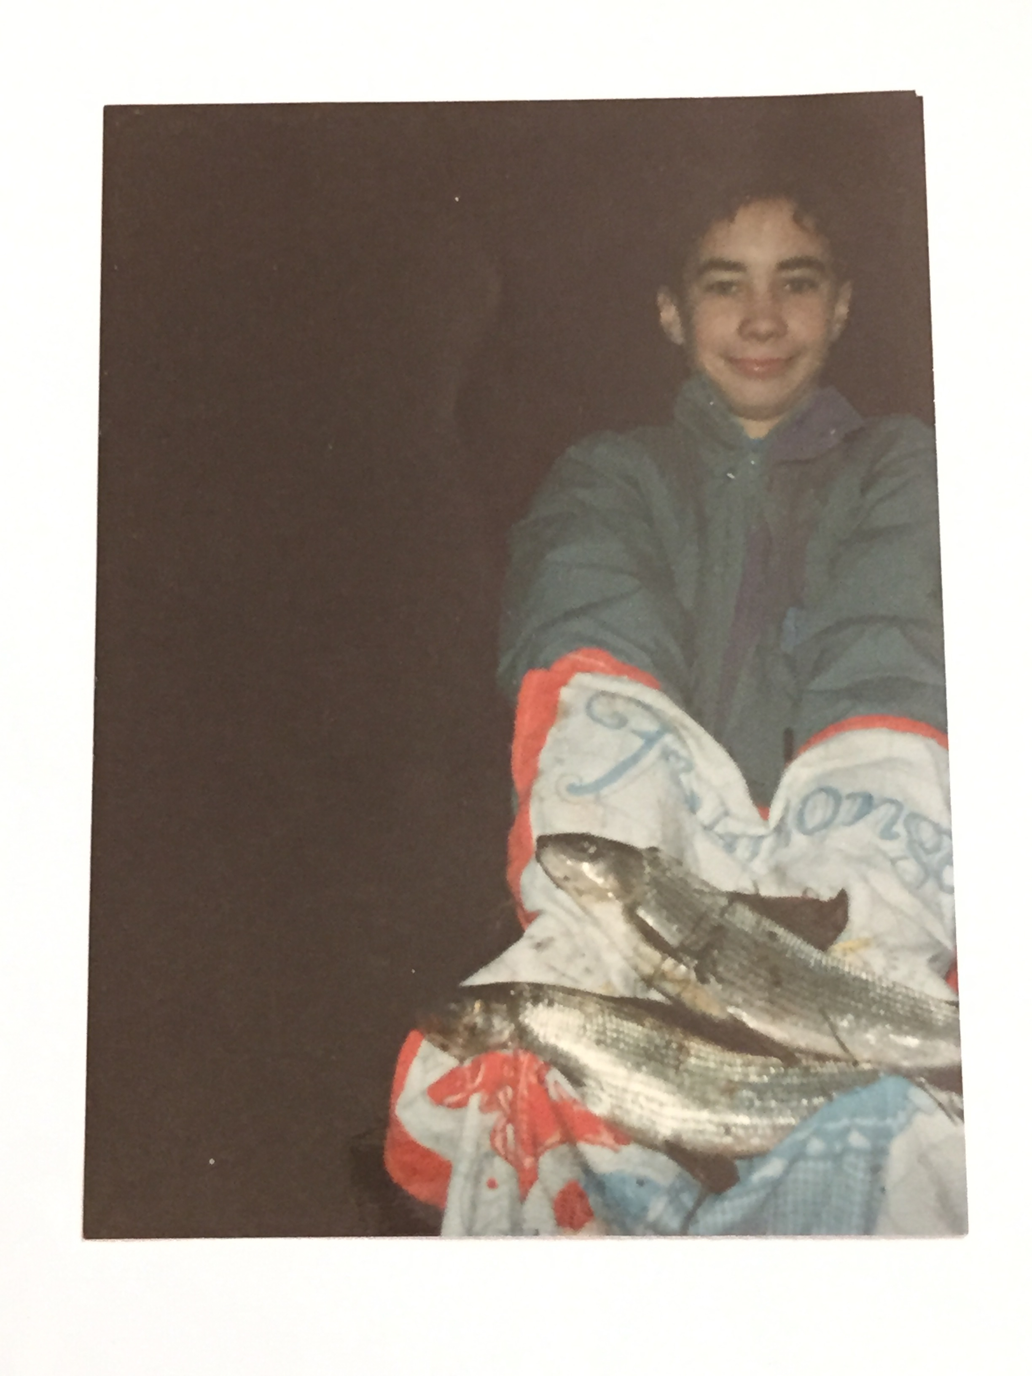
Text box
he was.
³⁵ Very early in the morning, while it was still dark, Jesus got up, left the house and went off to a solitary place, where he prayed. Simon and his companions went to look for him, ³⁷ and when they found him, they exclaimed: “Everyone is looking for you!”

Slide 4
Text box
he was.
³⁵ Very early in the morning, while it was still dark, Jesus got up, left the house and went off to a solitary place, where he prayed. Simon and his companions went to look for him, ³⁷ and when they found him, they exclaimed: “Everyone is looking for you!”

Slide 5
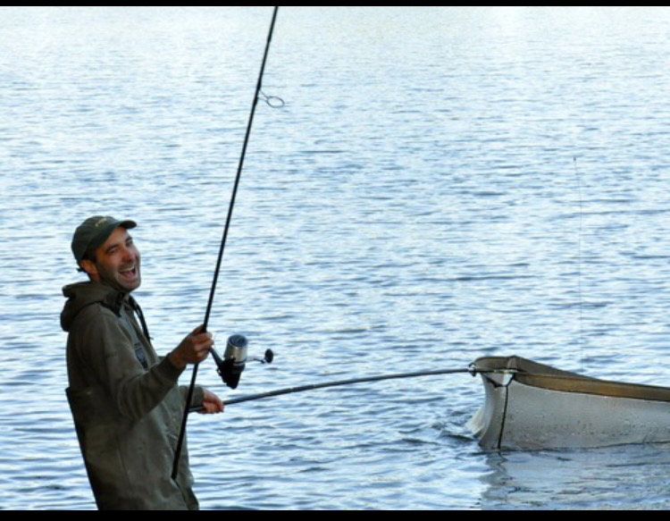
Text box
he was.
³⁵ Very early in the morning, while it was still dark, Jesus got up, left the house and went off to a solitary place, where he prayed. Simon and his companions went to look for him, ³⁷ and when they found him, they exclaimed: “Everyone is looking for you!”

Slide 6
Text box
John 2:1-12
On the third day a wedding took place at Cana in Galilee. Jesus’ mother was there, ² and Jesus and his disciples had also been invited to the wedding. ³ When the wine was gone, Jesus’ mother said to him, “They have no more wine.”
he was.
³⁵ Very early in the morning, while it was still dark, Jesus got up, left the house and went off to a solitary place, where he prayed. Simon and his companions went to look for him, ³⁷ and when they found him, they exclaimed: “Everyone is looking for you!”

Slide 7
Text box
John 2:1-12
⁴ “Woman, why do you involve me?” Jesus replied. “My hour has not yet come.”
⁵ His mother said to the servants, “Do whatever he tells you.”
he was.
³⁵ Very early in the morning, while it was still dark, Jesus got up, left the house and went off to a solitary place, where he prayed. Simon and his companions went to look for him, ³⁷ and when they found him, they exclaimed: “Everyone is looking for you!”

Slide 8
Text box
John 2:1-12
⁶ Nearby stood six stone water jars, the kind used by the Jews for ceremonial washing, each holding from twenty to thirty gallons. ⁷ Jesus said to the servants, “Fill the jars with water”; so they filled them to the brim.
⁸ Then he told them, “Now draw some out and take it to the master of the banquet.”
he was.
³⁵ Very early in the morning, while it was still dark, Jesus got up, left the house and went off to a solitary place, where he prayed. Simon and his companions went to look for him, ³⁷ and when they found him, they exclaimed: “Everyone is looking for you!”

Slide 9
Text box
John 2:1-12
They did so, ⁹ and the master of the banquet tasted the water that had been turned into wine. He did not realize where it had come from, though the servants who had drawn the water knew. Then he called the bridegroom aside ¹⁰ and said, “Everyone brings out the choice wine first and then the cheaper wine after the guests have had too much to drink; but you have saved the best till now.”
he was.
³⁵ Very early in the morning, while it was still dark, Jesus got up, left the house and went off to a solitary place, where he prayed. Simon and his companions went to look for him, ³⁷ and when they found him, they exclaimed: “Everyone is looking for you!”

Slide 10
Text box
John 2:1-12
What Jesus did here in Cana of Galilee was the first of the signs through which he revealed his glory; and his disciples believed in him.
he was.
³⁵ Very early in the morning, while it was still dark, Jesus got up, left the house and went off to a solitary place, where he prayed. Simon and his companions went to look for him, ³⁷ and when they found him, they exclaimed: “Everyone is looking for you!”

