Slide 1
Text box
he was.
³⁵ Very early in the morning, while it was still dark, Jesus got up, left the house and went off to a solitary place, where he prayed. Simon and his companions went to look for him, ³⁷ and when they found him, they exclaimed: “Everyone is looking for you!”

Slide 2
Text box
We Believe & We Act.
he was.
³⁵ Very early in the morning, while it was still dark, Jesus got up, left the house and went off to a solitary place, where he prayed. Simon and his companions went to look for him, ³⁷ and when they found him, they exclaimed: “Everyone is looking for you!”

Slide 3
Text box
Vision (words) = Inspiration
Mission (action) = Traction
he was.
³⁵ Very early in the morning, while it was still dark, Jesus got up, left the house and went off to a solitary place, where he prayed. Simon and his companions went to look for him, ³⁷ and when they found him, they exclaimed: “Everyone is looking for you!”

Slide 4
Text box
he was.
³⁵ Very early in the morning, while it was still dark, Jesus got up, left the house and went off to a solitary place, where he prayed. Simon and his companions went to look for him, ³⁷ and when they found him, they exclaimed: “Everyone is looking for you!”

Slide 5
Text box
We Believe & We Act.
he was.
³⁵ Very early in the morning, while it was still dark, Jesus got up, left the house and went off to a solitary place, where he prayed. Simon and his companions went to look for him, ³⁷ and when they found him, they exclaimed: “Everyone is looking for you!”

Slide 6
Text box
OT: People of God
NT: Come follow me
he was.
³⁵ Very early in the morning, while it was still dark, Jesus got up, left the house and went off to a solitary place, where he prayed. Simon and his companions went to look for him, ³⁷ and when they found him, they exclaimed: “Everyone is looking for you!”

Slide 7
Text box
Matthew 11:28-40 (NLT)
²⁸ Then Jesus said, “Come to me, all of you who are weary and carry heavy burdens, and I will give you rest.
he was.
³⁵ Very early in the morning, while it was still dark, Jesus got up, left the house and went off to a solitary place, where he prayed. Simon and his companions went to look for him, ³⁷ and when they found him, they exclaimed: “Everyone is looking for you!”

Slide 8
Text box
Matthew 11:28-40 (NLT)
²⁹ Take my yoke upon you. Let me teach you, because I am humble and gentle at heart, and you will find rest for your souls.
he was.
³⁵ Very early in the morning, while it was still dark, Jesus got up, left the house and went off to a solitary place, where he prayed. Simon and his companions went to look for him, ³⁷ and when they found him, they exclaimed: “Everyone is looking for you!”

Slide 9
Text box
Matthew 11:28-40 (NLT)
³⁰ For my yoke is easy to bear, and the burden I give you is light.”
he was.
³⁵ Very early in the morning, while it was still dark, Jesus got up, left the house and went off to a solitary place, where he prayed. Simon and his companions went to look for him, ³⁷ and when they found him, they exclaimed: “Everyone is looking for you!”

Slide 10
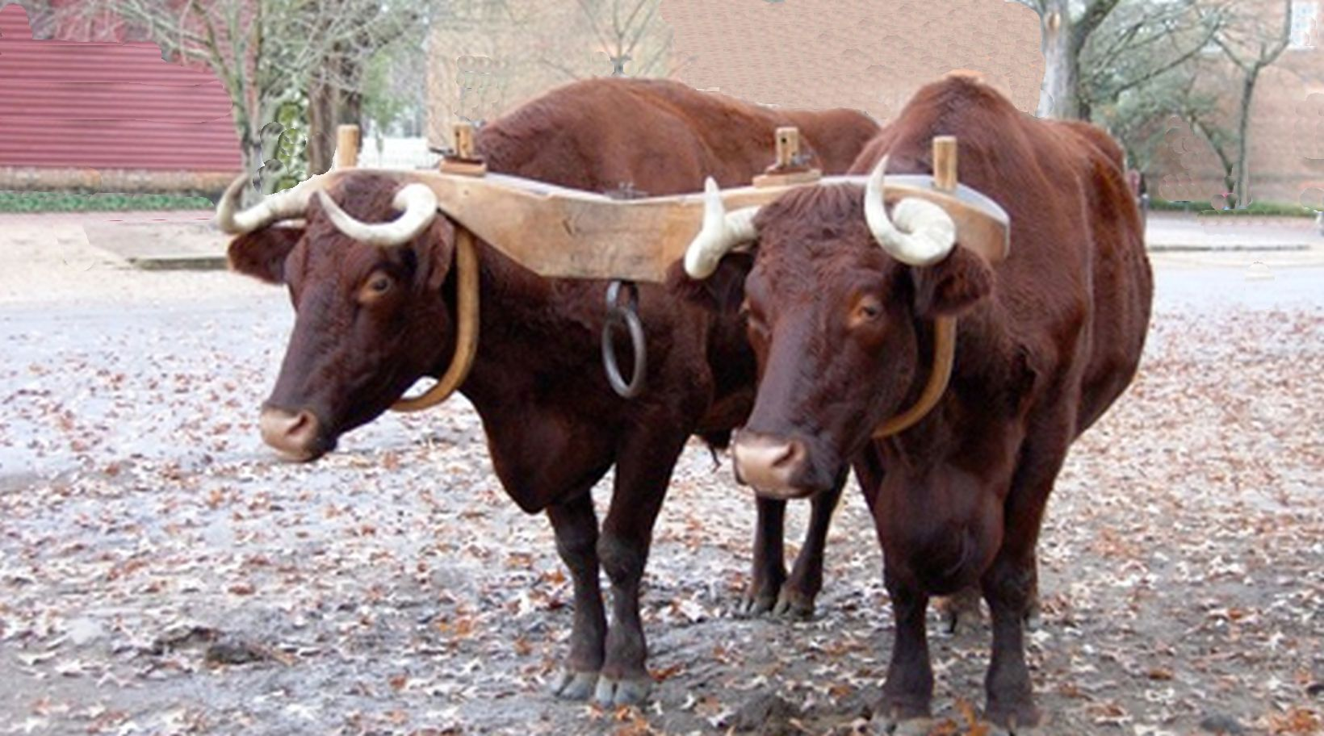
Text box
he was.
³⁵ Very early in the morning, while it was still dark, Jesus got up, left the house and went off to a solitary place, where he prayed. Simon and his companions went to look for him, ³⁷ and when they found him, they exclaimed: “Everyone is looking for you!”

Slide 11
Text box
We Believe & We Act.
he was.
³⁵ Very early in the morning, while it was still dark, Jesus got up, left the house and went off to a solitary place, where he prayed. Simon and his companions went to look for him, ³⁷ and when they found him, they exclaimed: “Everyone is looking for you!”

