Slide 1
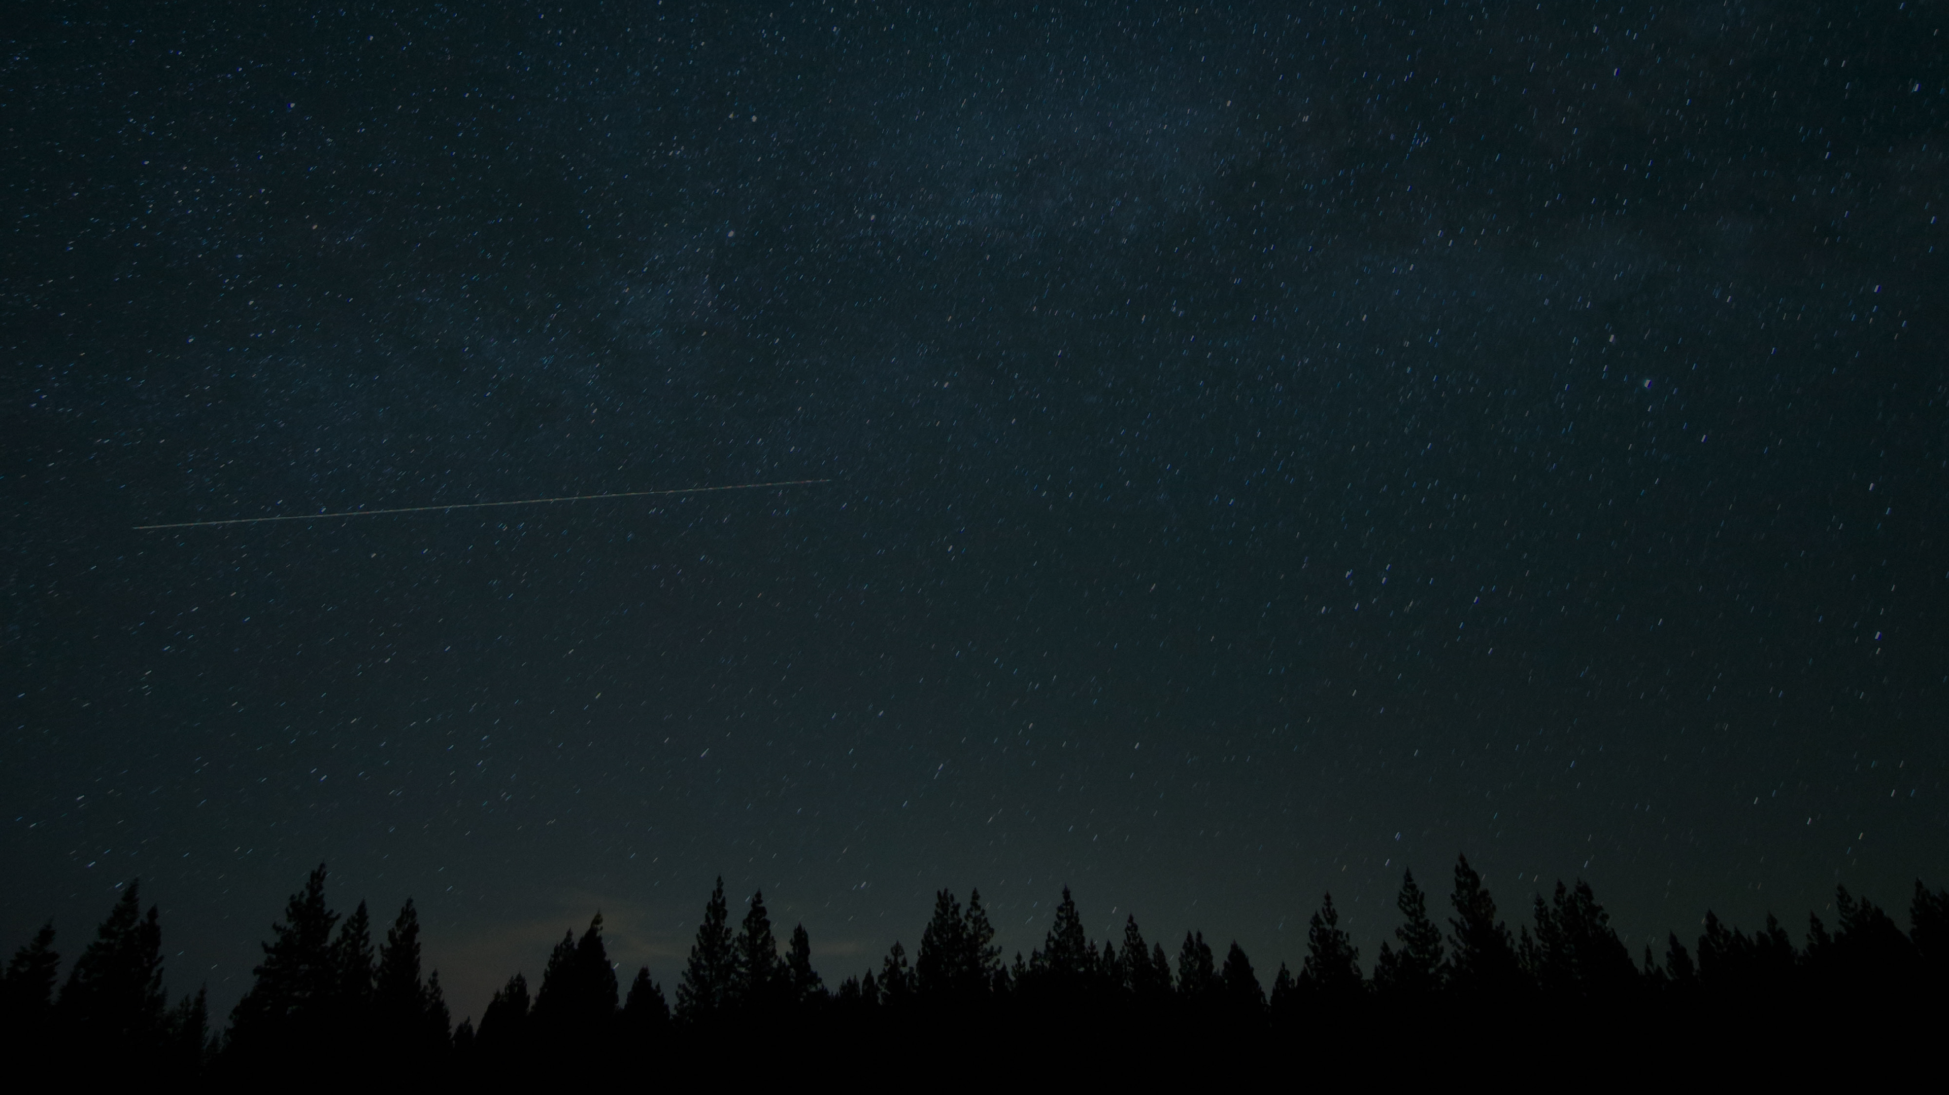
Text box
Traffic Lights
The Gospel according to La La Land
he was.
³⁵ Very early in the morning, while it was still dark, Jesus got up, left the house and went off to a solitary place, where he prayed. Simon and his companions went to look for him, ³⁷ and when they found him, they exclaimed: “Everyone is looking for you!”

Slide 2
Text box
Traffic Lights
Genesis 1:26-31
²⁶ Then God said, “Let us make mankind in our image, in our likeness, so that they may rule over the fish in the sea and the birds in the sky, over the livestock and all the wild animals, and over all the creatures that move along the ground.”
he was.
³⁵ Very early in the morning, while it was still dark, Jesus got up, left the house and went off to a solitary place, where he prayed. Simon and his companions went to look for him, ³⁷ and when they found him, they exclaimed: “Everyone is looking for you!”

Slide 3
Text box
Traffic Lights
Genesis 1:26-31
²⁷ So God created mankind in his own image, in the image of God he created them; male and female he created them.
²⁸ God blessed them and said to them, “Be fruitful and increase in number; fill the earth and subdue it.
he was.
³⁵ Very early in the morning, while it was still dark, Jesus got up, left the house and went off to a solitary place, where he prayed. Simon and his companions went to look for him, ³⁷ and when they found him, they exclaimed: “Everyone is looking for you!”

Slide 4
Text box
Traffic Lights
Genesis 1:26-31
Rule over the fish in the sea and the birds in the sky and over every living creature that moves on the ground.”
²⁹ Then God said, “I give you every seed-bearing plant on the face of the whole earth and every tree that has fruit with seed in it. They will be yours for food.
he was.
³⁵ Very early in the morning, while it was still dark, Jesus got up, left the house and went off to a solitary place, where he prayed. Simon and his companions went to look for him, ³⁷ and when they found him, they exclaimed: “Everyone is looking for you!”

Slide 5
Text box
Traffic Lights
Genesis 1:26-31
³⁰ And to all the beasts of the earth and all the birds in the sky and all the creatures that move along the ground—everything that has the breath of life in it—I give every green plant for food.” And it was so.
.
he was.
³⁵ Very early in the morning, while it was still dark, Jesus got up, left the house and went off to a solitary place, where he prayed. Simon and his companions went to look for him, ³⁷ and when they found him, they exclaimed: “Everyone is looking for you!”

Slide 6
Text box
Traffic Lights
Genesis 1:26-31
³¹ God saw all that he had made, and it was very good. And there was evening, and there was morning—the sixth day.
he was.
³⁵ Very early in the morning, while it was still dark, Jesus got up, left the house and went off to a solitary place, where he prayed. Simon and his companions went to look for him, ³⁷ and when they found him, they exclaimed: “Everyone is looking for you!”

Slide 7
Text box
Traffic Lights
Exodus 6:2-7
² God also said to Moses, “I am the Lord. ³ I appeared to Abraham, to Isaac and to Jacob as God Almighty, but by my name the Lord I did not make myself fully known to them.
he was.
³⁵ Very early in the morning, while it was still dark, Jesus got up, left the house and went off to a solitary place, where he prayed. Simon and his companions went to look for him, ³⁷ and when they found him, they exclaimed: “Everyone is looking for you!”

Slide 8
Text box
Traffic Lights
Exodus 6:2-7
⁴ I also established my covenant with them to give them the land of Canaan, where they resided as foreigners. ⁵ Moreover, I have heard the groaning of the Israelites, whom the Egyptians are enslaving, and I have remembered my covenant.
he was.
³⁵ Very early in the morning, while it was still dark, Jesus got up, left the house and went off to a solitary place, where he prayed. Simon and his companions went to look for him, ³⁷ and when they found him, they exclaimed: “Everyone is looking for you!”

Slide 9
Text box
Traffic Lights
Exodus 6:2-7
⁶ “Therefore, say to the Israelites: ‘I am the Lord, and I will bring you out from under the yoke of the Egyptians. I will free you from being slaves to them, and I will redeem you with an outstretched arm and with mighty acts of judgment.
he was.
³⁵ Very early in the morning, while it was still dark, Jesus got up, left the house and went off to a solitary place, where he prayed. Simon and his companions went to look for him, ³⁷ and when they found him, they exclaimed: “Everyone is looking for you!”

Slide 10
Text box
Traffic Lights
Exodus 6:2-7
⁷ I will take you as my own people, and I will be your God. Then you will know that I am the Lord your God, who brought you out from under the yoke of the Egyptians.
he was.
³⁵ Very early in the morning, while it was still dark, Jesus got up, left the house and went off to a solitary place, where he prayed. Simon and his companions went to look for him, ³⁷ and when they found him, they exclaimed: “Everyone is looking for you!”

Slide 11
Text box
Traffic Lights
Malachi 3:16-18
¹⁶ Then those who feared the Lord talked with each other, and the Lord listened and heard. A scroll of remembrance was written in his presence concerning those who feared the Lord and honored his name.
he was.
³⁵ Very early in the morning, while it was still dark, Jesus got up, left the house and went off to a solitary place, where he prayed. Simon and his companions went to look for him, ³⁷ and when they found him, they exclaimed: “Everyone is looking for you!”

Slide 12
Text box
Traffic Lights
Malachi 3:16-17
¹⁷ “On the day when I act,” says the Lord Almighty, “they will be my treasured possession.
he was.
³⁵ Very early in the morning, while it was still dark, Jesus got up, left the house and went off to a solitary place, where he prayed. Simon and his companions went to look for him, ³⁷ and when they found him, they exclaimed: “Everyone is looking for you!”

Slide 13
Text box
Traffic Lights
Luke 4:16-21
¹⁶ He went to Nazareth, where he had been brought up, and on the Sabbath day he went into the synagogue, as was his custom. He stood up to read, ¹⁷ and the scroll of the prophet Isaiah was handed to him.
he was.
³⁵ Very early in the morning, while it was still dark, Jesus got up, left the house and went off to a solitary place, where he prayed. Simon and his companions went to look for him, ³⁷ and when they found him, they exclaimed: “Everyone is looking for you!”

Slide 14
Text box
Traffic Lights
Luke 4:16-21
Unrolling it, he found the place where it is written:
¹⁸ “The Spirit of the Lord is on me, because he has anointed me to proclaim good news to the poor.
he was.
³⁵ Very early in the morning, while it was still dark, Jesus got up, left the house and went off to a solitary place, where he prayed. Simon and his companions went to look for him, ³⁷ and when they found him, they exclaimed: “Everyone is looking for you!”

Slide 15
Text box
Traffic Lights
Luke 4:16-21
He has sent me to proclaim freedom for the prisoners and recovery of sight for the blind, to set the oppressed free, ¹⁹ to proclaim the year of the Lord’s favor.”
he was.
³⁵ Very early in the morning, while it was still dark, Jesus got up, left the house and went off to a solitary place, where he prayed. Simon and his companions went to look for him, ³⁷ and when they found him, they exclaimed: “Everyone is looking for you!”

Slide 16
Text box
Traffic Lights
Luke 4:16-21
²⁰ Then he rolled up the scroll, gave it back to the attendant and sat down. The eyes of everyone in the synagogue were fastened on him. ²¹ He began by saying to them, “Today this scripture is fulfilled in your hearing.”
he was.
³⁵ Very early in the morning, while it was still dark, Jesus got up, left the house and went off to a solitary place, where he prayed. Simon and his companions went to look for him, ³⁷ and when they found him, they exclaimed: “Everyone is looking for you!”

Slide 17
Text box
Traffic Lights
Revelation 21:2-4
² I saw the Holy City, the new Jerusalem, coming down out of heaven from God, prepared as a bride beautifully dressed for her husband.
he was.
³⁵ Very early in the morning, while it was still dark, Jesus got up, left the house and went off to a solitary place, where he prayed. Simon and his companions went to look for him, ³⁷ and when they found him, they exclaimed: “Everyone is looking for you!”

Slide 18
Text box
Traffic Lights
Revelation 21:2-4
³ And I heard a loud voice from the throne saying, “Look! God’s dwelling place is now among the people, and he will dwell with them. They will be his people, and God himself will be with them and be their God.
he was.
³⁵ Very early in the morning, while it was still dark, Jesus got up, left the house and went off to a solitary place, where he prayed. Simon and his companions went to look for him, ³⁷ and when they found him, they exclaimed: “Everyone is looking for you!”

Slide 19
Text box
Traffic Lights
Revelation 21:2-4
⁴ ‘He will wipe every tear from their eyes. There will be no more death’ or mourning or crying or pain, for the old order of things has passed away.”
he was.
³⁵ Very early in the morning, while it was still dark, Jesus got up, left the house and went off to a solitary place, where he prayed. Simon and his companions went to look for him, ³⁷ and when they found him, they exclaimed: “Everyone is looking for you!”

Slide 20
Text box
Traffic Lights
One Song (music)
The last song sounds like the first song.
It continues to play. Subtle at times (have we lost it). Obvious crescendo moments at other times (Jesus)
One song.
he was.
³⁵ Very early in the morning, while it was still dark, Jesus got up, left the house and went off to a solitary place, where he prayed. Simon and his companions went to look for him, ³⁷ and when they found him, they exclaimed: “Everyone is looking for you!”

Slide 21
Text box
Traffic Lights
One Song (Bible)
The last song sounds like the first song.
It continues to play. Subtle at times (have we lost it). Obvious crescendo moments at other times (Jesus)
One song.
One story.
One Lord.
he was.
³⁵ Very early in the morning, while it was still dark, Jesus got up, left the house and went off to a solitary place, where he prayed. Simon and his companions went to look for him, ³⁷ and when they found him, they exclaimed: “Everyone is looking for you!”

Slide 22
Text box
Traffic Lights
One Song (Bible)
God loves people.
He reaches out to people, always.
Jesus embodies this message and makes relationship possible
he was.
³⁵ Very early in the morning, while it was still dark, Jesus got up, left the house and went off to a solitary place, where he prayed. Simon and his companions went to look for him, ³⁷ and when they found him, they exclaimed: “Everyone is looking for you!”

Slide 23
Text box
Traffic Lights
What should we do?
Join the song.
Sing it to others.
he was.
³⁵ Very early in the morning, while it was still dark, Jesus got up, left the house and went off to a solitary place, where he prayed. Simon and his companions went to look for him, ³⁷ and when they found him, they exclaimed: “Everyone is looking for you!”

