Slide 1
Text box
Seek and you will find.

Slide 2
Text box
Matthew 7:7-8
Ask and it will be given to you; seek and you will find; knock and the door will be opened to you. ⁸ For everyone who asks receives; the one who seeks finds; and to the one who knocks, the door will be opened.

Slide 3
Text box
John 15:7-8
If you remain in me and my words remain in you, ask whatever you wish, and it will be done for you. ⁸ This is to my Father’s glory, that you bear much fruit, showing yourselves to be my disciples.

Slide 4
Text box
John 15:7-8
If you remain in me and my words remain in you, ask whatever you wish, and it will be done for you. ⁸ This is to my Father’s glory, that you bear much fruit, showing yourselves to be my disciples.

Slide 5
Text box

Slide 6
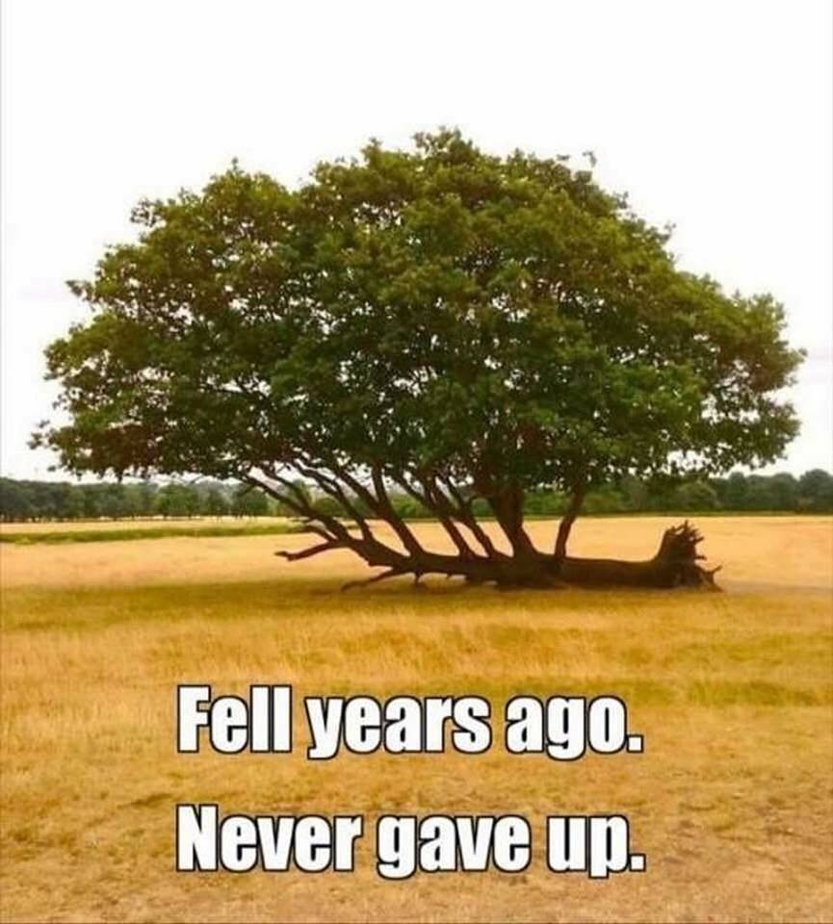
Text box

Slide 7
Text box
Seek and you will find.

