Slide 1
PSALM 23
MAKING SPACE FOR GOD

Slide 2
Psalm 127:2
“It is in vain that you rise up early and go late to rest, eating the
bread of anxious toil; for he gives sleep to his beloved.”

Slide 3
Psalm 23
The Lord is my shepherd, I lack nothing. He makes me lie down in green pastures, he leads me beside quiet waters, he refreshes my soul. He guides me along the right path for his name’s sake. Even though I walk through the darkest valley, I will fear no evil, for you are with me…

Slide 4
Psalm 23…
Your rod and your staff, they comfort me. You prepare a table before me in the presence of my enemies. You anoint my head with oil, my cup overflows. Surely your goodness and love will follow me all the days of my life, and I will dwell in the house of the Lord forever.

Slide 5
MAKING SPACE FOR GOD…
FIRST
Sheep will not lie down unless they are FREE FROM FEAR…
“I prayed to the Lord, and he answered me. He freed me from all my fears.”…
“For the angel of the Lord is a guard; he surrounds and defends all who fear him.”
Psalm 34:4&7

Slide 6
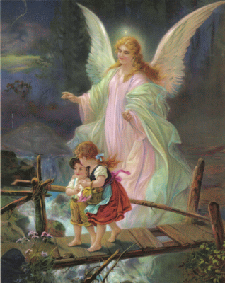
Psalm 34:7

Slide 7
MAKING SPACE FOR GOD…
SECOND…
Sheep will not to lie down if there is TENSION, RIVALRY AND CRUEL COMPETITION WITHIN THE FLOCK
“We have no right to judge where we should be put, or to have preconceived notions as to what God is fitting us for. God engineers everything; wherever He puts us, our one great aim is to pour out a whole-hearted devotion to Him in that particular work.”
Oswald Chambers “My Utmost for His Highest”

Slide 8
MAKING SPACE FOR GOD…
THIRD…
Sheep will not lie down if there are DISTRACTIONS AND PESTS IN THE PASTURE.
FOURTH…
Sheep will not rest because of
HUNGER AND THIRST.

Slide 9
MAKING SPACE FOR GOD…
“Trust in the Lord and do good;
dwell in the land and enjoy safe pasture.
Delight yourself in the Lord and He
will give you the
desires of your heart.” Psalm 37:3-4

