Slide 1
Text box
In God We Trust
he was.
³⁵ Very early in the morning, while it was still dark, Jesus got up, left the house and went off to a solitary place, where he prayed. Simon and his companions went to look for him, ³⁷ and when they found him, they exclaimed: “Everyone is looking for you!”

Slide 2
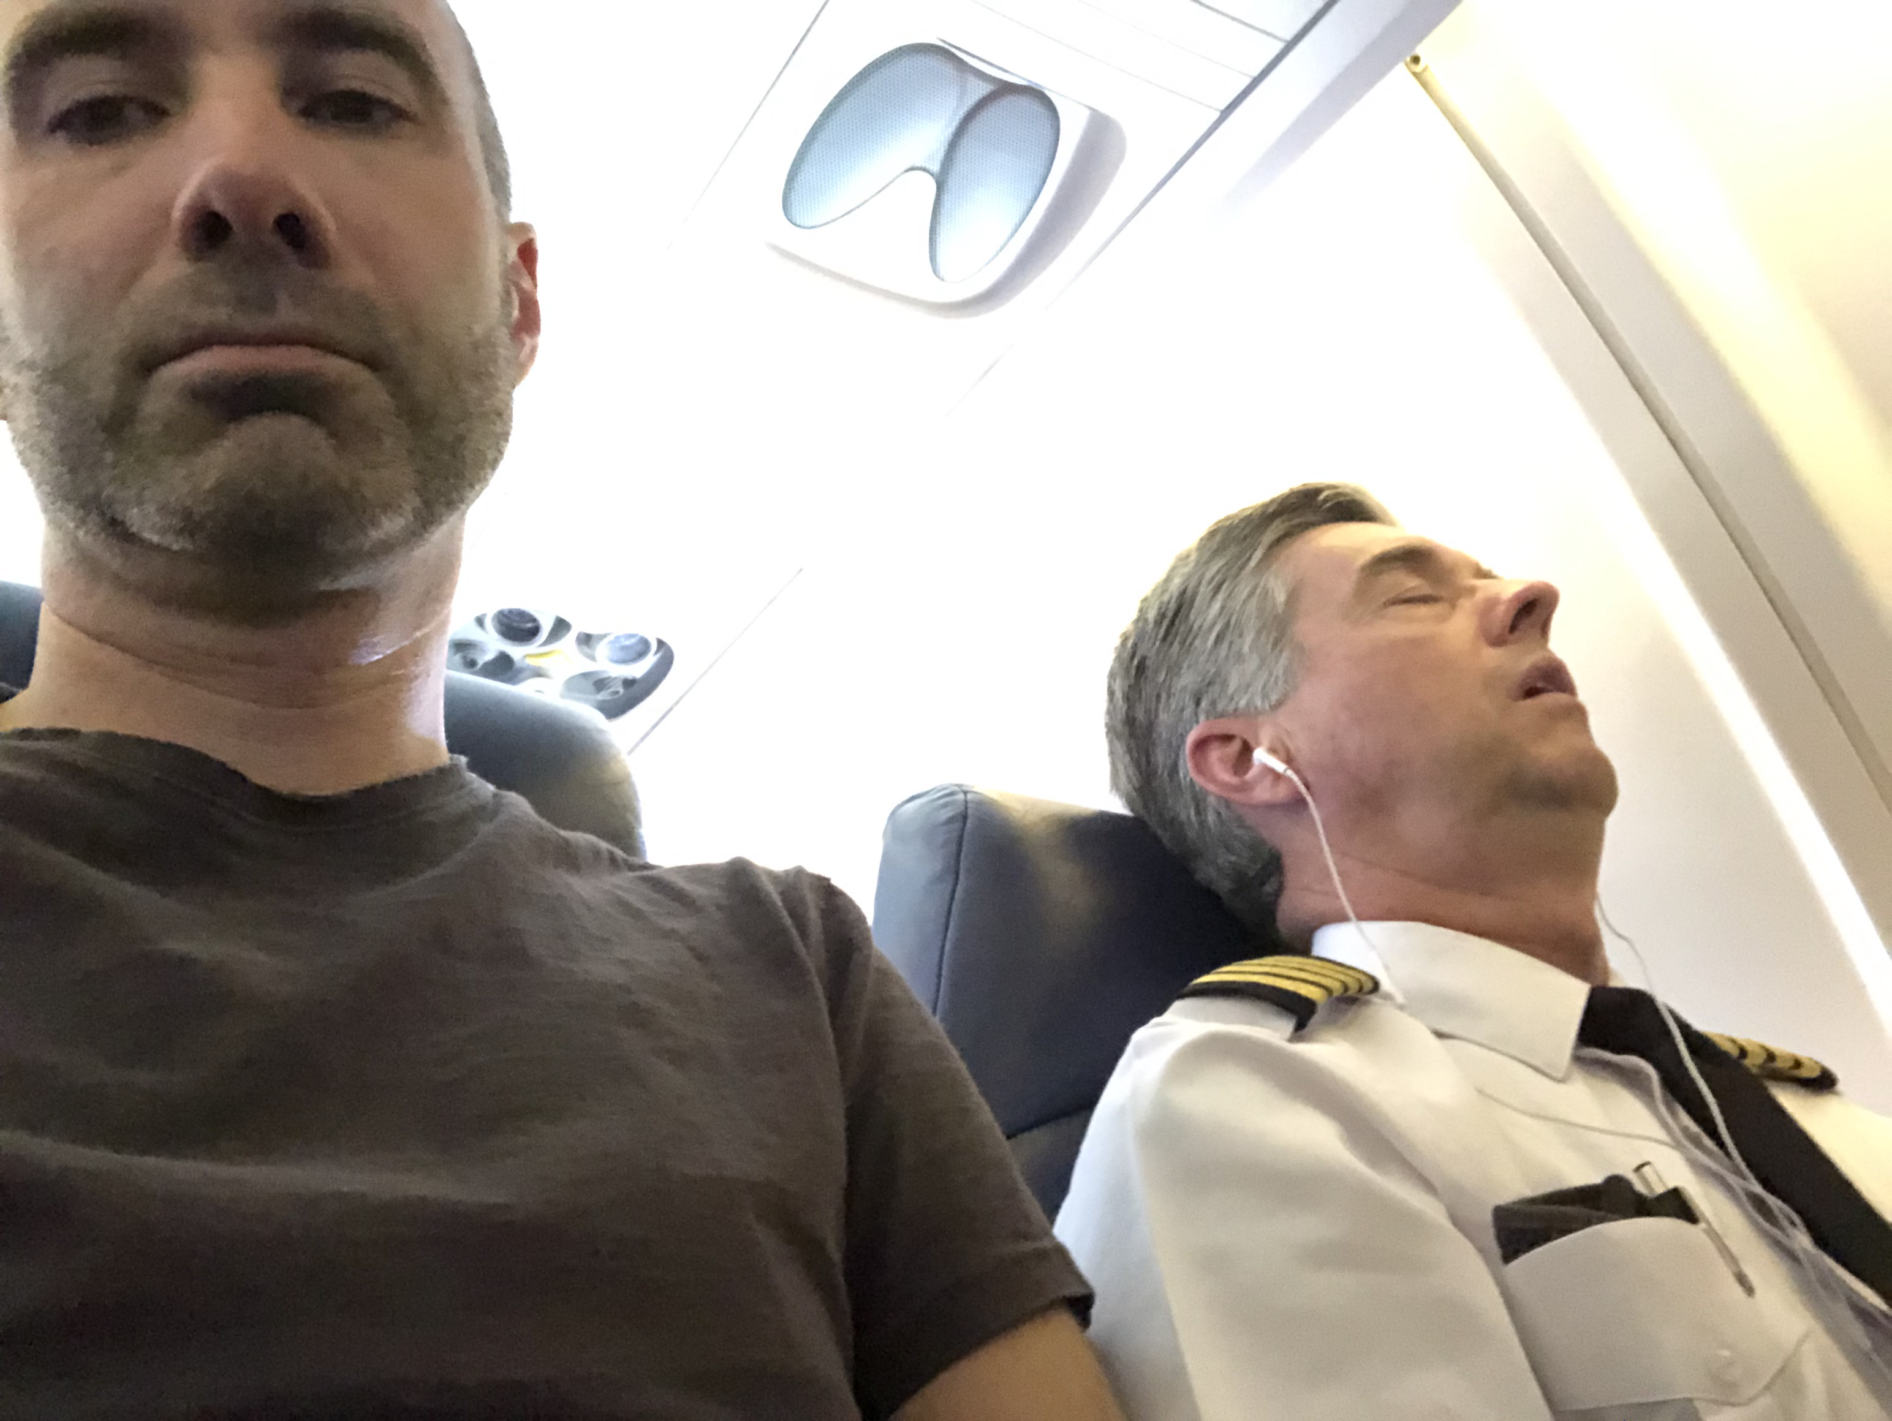
Text box
he was.
³⁵ Very early in the morning, while it was still dark, Jesus got up, left the house and went off to a solitary place, where he prayed. Simon and his companions went to look for him, ³⁷ and when they found him, they exclaimed: “Everyone is looking for you!”

Slide 3
Text box
Psalm 20:7
Some trust in chariots
and some in horses, but we trust in the name of the Lord our God.
he was.
³⁵ Very early in the morning, while it was still dark, Jesus got up, left the house and went off to a solitary place, where he prayed. Simon and his companions went to look for him, ³⁷ and when they found him, they exclaimed: “Everyone is looking for you!”

Slide 4
Text box
Proverbs 3:5
Trust in the Lord with all your heart and lean not on your own understanding
he was.
³⁵ Very early in the morning, while it was still dark, Jesus got up, left the house and went off to a solitary place, where he prayed. Simon and his companions went to look for him, ³⁷ and when they found him, they exclaimed: “Everyone is looking for you!”

Slide 5
Text box
God’s financial plan
1. Framework (Tithe)
2. Spontaneity (Gifts)
he was.
³⁵ Very early in the morning, while it was still dark, Jesus got up, left the house and went off to a solitary place, where he prayed. Simon and his companions went to look for him, ³⁷ and when they found him, they exclaimed: “Everyone is looking for you!”

Slide 6
Text box
he was.
³⁵ Very early in the morning, while it was still dark, Jesus got up, left the house and went off to a solitary place, where he prayed. Simon and his companions went to look for him, ³⁷ and when they found him, they exclaimed: “Everyone is looking for you!”

Slide 7
Text box
Genesis 14:20
Then Abram gave him a tenth of everything
he was.
³⁵ Very early in the morning, while it was still dark, Jesus got up, left the house and went off to a solitary place, where he prayed. Simon and his companions went to look for him, ³⁷ and when they found him, they exclaimed: “Everyone is looking for you!”

Slide 8
Text box
Genesis 28:22
This stone that I have set up as a pillar will be God’s house, and of all that you give me I will give you a tenth.
he was.
³⁵ Very early in the morning, while it was still dark, Jesus got up, left the house and went off to a solitary place, where he prayed. Simon and his companions went to look for him, ³⁷ and when they found him, they exclaimed: “Everyone is looking for you!”

Slide 9
Text box
Leviticus 27:30
A tithe of everything from the land, whether grain from the soil or fruit from the trees, belongs to the Lord; it is holy to the Lord
he was.
³⁵ Very early in the morning, while it was still dark, Jesus got up, left the house and went off to a solitary place, where he prayed. Simon and his companions went to look for him, ³⁷ and when they found him, they exclaimed: “Everyone is looking for you!”

Slide 10
Text box
2 Chronicles 31:5
As soon as the order went out, the Israelites generously gave the first fruits of their grain, new wine, olive oil and honey and all that the fields produced. They brought a great amount, a tithe of everything.
he was.
³⁵ Very early in the morning, while it was still dark, Jesus got up, left the house and went off to a solitary place, where he prayed. Simon and his companions went to look for him, ³⁷ and when they found him, they exclaimed: “Everyone is looking for you!”

Slide 11
Text box
Matthew 5:17
Do not think that I have come to abolish the Law or the Prophets; I have not come to abolish them but to fulfill them.
he was.
³⁵ Very early in the morning, while it was still dark, Jesus got up, left the house and went off to a solitary place, where he prayed. Simon and his companions went to look for him, ³⁷ and when they found him, they exclaimed: “Everyone is looking for you!”

Slide 12
Text box
Malachi 3:6-12
⁶ “I the Lord do not change. So you, the descendants of Jacob, are not destroyed. ⁷ Ever since the time of your ancestors you have turned away from my decrees and have not kept them.
he was.
³⁵ Very early in the morning, while it was still dark, Jesus got up, left the house and went off to a solitary place, where he prayed. Simon and his companions went to look for him, ³⁷ and when they found him, they exclaimed: “Everyone is looking for you!”

Slide 13
Text box
Malachi 3:6-12
Return to me, and I will return to you,” says the Lord Almighty.
“But you ask, ‘How are we to return?’
he was.
³⁵ Very early in the morning, while it was still dark, Jesus got up, left the house and went off to a solitary place, where he prayed. Simon and his companions went to look for him, ³⁷ and when they found him, they exclaimed: “Everyone is looking for you!”

Slide 14
Text box
Malachi 3:6-12
⁸ “Will a mere mortal rob God? Yet you rob me.
“But you ask, ‘How are we robbing you?’
he was.
³⁵ Very early in the morning, while it was still dark, Jesus got up, left the house and went off to a solitary place, where he prayed. Simon and his companions went to look for him, ³⁷ and when they found him, they exclaimed: “Everyone is looking for you!”

Slide 15
Text box
Malachi 3:6-12
“In tithes and offerings. ⁹ You are under a curse—your whole nation—because you are robbing me. ¹⁰ Bring the whole tithe into the storehouse, that there may be food in my house.
he was.
³⁵ Very early in the morning, while it was still dark, Jesus got up, left the house and went off to a solitary place, where he prayed. Simon and his companions went to look for him, ³⁷ and when they found him, they exclaimed: “Everyone is looking for you!”

Slide 16
Text box
Malachi 3:6-12
Test me in this,” says the Lord Almighty, “and see if I will not throw open the floodgates of heaven and pour out so much blessing that there will not be room enough to store it. ¹¹
he was.
³⁵ Very early in the morning, while it was still dark, Jesus got up, left the house and went off to a solitary place, where he prayed. Simon and his companions went to look for him, ³⁷ and when they found him, they exclaimed: “Everyone is looking for you!”

Slide 17
Text box
Malachi 3:6-12
I will prevent pests from devouring your crops, and the vines in your fields will not drop their fruit before it is ripe,” says the Lord Almighty.
he was.
³⁵ Very early in the morning, while it was still dark, Jesus got up, left the house and went off to a solitary place, where he prayed. Simon and his companions went to look for him, ³⁷ and when they found him, they exclaimed: “Everyone is looking for you!”

Slide 18
Text box
Malachi 3:6-12
¹² “Then all the nations will call you blessed, for yours will be a delightful land,” says the Lord Almighty.
he was.
³⁵ Very early in the morning, while it was still dark, Jesus got up, left the house and went off to a solitary place, where he prayed. Simon and his companions went to look for him, ³⁷ and when they found him, they exclaimed: “Everyone is looking for you!”

Slide 19
Text box
Malachi 3:6-12
^{I do not change}
You are not destroyed because of my grace
^{Curses and blessings}
Bring into the storehouse, that there may be food in my house (Banquet, Matthew 22)
^{You will be blessed}
^{Test me in this}
he was.
³⁵ Very early in the morning, while it was still dark, Jesus got up, left the house and went off to a solitary place, where he prayed. Simon and his companions went to look for him, ³⁷ and when they found him, they exclaimed: “Everyone is looking for you!”

Slide 20
Text box
God doesn’t want your money, he wants your heart
he was.
³⁵ Very early in the morning, while it was still dark, Jesus got up, left the house and went off to a solitary place, where he prayed. Simon and his companions went to look for him, ³⁷ and when they found him, they exclaimed: “Everyone is looking for you!”

Slide 21
Text box
Mark 12:41-44
⁴¹ Jesus sat down opposite the place where the offerings were put and watched the crowd putting their money into the temple treasury.
he was.
³⁵ Very early in the morning, while it was still dark, Jesus got up, left the house and went off to a solitary place, where he prayed. Simon and his companions went to look for him, ³⁷ and when they found him, they exclaimed: “Everyone is looking for you!”

Slide 22
Text box
Mark 12:41-44
Many rich people threw in large amounts. ⁴² But a poor widow came and put in two very small copper coins, worth only a few cents.
he was.
³⁵ Very early in the morning, while it was still dark, Jesus got up, left the house and went off to a solitary place, where he prayed. Simon and his companions went to look for him, ³⁷ and when they found him, they exclaimed: “Everyone is looking for you!”

Slide 23
Text box
Mark 12:41-44
⁴³ Calling his disciples to him, Jesus said, “Truly I tell you, this poor widow has put more into the treasury than all the others. ⁴⁴ They all gave out of their wealth; but she, out of her poverty, put in everything—all she had to live on.”
he was.
³⁵ Very early in the morning, while it was still dark, Jesus got up, left the house and went off to a solitary place, where he prayed. Simon and his companions went to look for him, ³⁷ and when they found him, they exclaimed: “Everyone is looking for you!”

Slide 24
Text box
he was.
³⁵ Very early in the morning, while it was still dark, Jesus got up, left the house and went off to a solitary place, where he prayed. Simon and his companions went to look for him, ³⁷ and when they found him, they exclaimed: “Everyone is looking for you!”

Slide 25
Text box
Psalm 20:7
Some trust in chariots
and some in horses, but we trust in the name of the Lord our God.
he was.
³⁵ Very early in the morning, while it was still dark, Jesus got up, left the house and went off to a solitary place, where he prayed. Simon and his companions went to look for him, ³⁷ and when they found him, they exclaimed: “Everyone is looking for you!”

