Slide 1
Text box
he was.
³⁵ Very early in the morning, while it was still dark, Jesus got up, left the house and went off to a solitary place, where he prayed. Simon and his companions went to look for him, ³⁷ and when they found him, they exclaimed: “Everyone is looking for you!”

Slide 2
Text box
Ephesians 3:16-19
Roots
he was.
³⁵ Very early in the morning, while it was still dark, Jesus got up, left the house and went off to a solitary place, where he prayed. Simon and his companions went to look for him, ³⁷ and when they found him, they exclaimed: “Everyone is looking for you!”

Slide 3
Text box
Ephesians 3:16-19
I pray that out of his glorious riches he may strengthen you with power through his Spirit in your inner being, ¹⁷ so that Christ may dwell in your hearts through faith.
he was.
³⁵ Very early in the morning, while it was still dark, Jesus got up, left the house and went off to a solitary place, where he prayed. Simon and his companions went to look for him, ³⁷ and when they found him, they exclaimed: “Everyone is looking for you!”

Slide 4
Text box
Ephesians 3:16-19
And I pray that you, being rooted and established in love, ¹⁸ may have power, together with all the Lord’s holy people, to grasp how wide and long and high and deep is the love of Christ, ¹⁹ and to know this love that surpasses knowledge—that you may be filled to the measure of all the fullness of God.
.
he was.
³⁵ Very early in the morning, while it was still dark, Jesus got up, left the house and went off to a solitary place, where he prayed. Simon and his companions went to look for him, ³⁷ and when they found him, they exclaimed: “Everyone is looking for you!”

Slide 5
Text box
There’s life in the roots
he was.
³⁵ Very early in the morning, while it was still dark, Jesus got up, left the house and went off to a solitary place, where he prayed. Simon and his companions went to look for him, ³⁷ and when they found him, they exclaimed: “Everyone is looking for you!”

Slide 6
Text box
Psalm 1:1-3
Blessed is the one who does not walk in step with the wicked or stand in the way that sinners take or sit in the company of mockers, ² but whose delight is in the law of the Lord, and who meditates on his law, day and night. ³ That person is like a tree planted by streams of water, which yields its fruit in season
he was.
³⁵ Very early in the morning, while it was still dark, Jesus got up, left the house and went off to a solitary place, where he prayed. Simon and his companions went to look for him, ³⁷ and when they found him, they exclaimed: “Everyone is looking for you!”

Slide 7
Text box
Jeremiah 17:7-8
“But blessed is the one who trusts in the Lord, whose confidence is in him. ⁸ They will be like a tree planted by the water that sends out its roots by the stream. It does not fear when heat comes; its leaves are always green. It has no worries in a year of drought and never fails to bear fruit.”
he was.
³⁵ Very early in the morning, while it was still dark, Jesus got up, left the house and went off to a solitary place, where he prayed. Simon and his companions went to look for him, ³⁷ and when they found him, they exclaimed: “Everyone is looking for you!”

Slide 8
Text box
There can also be death in the roots
he was.
³⁵ Very early in the morning, while it was still dark, Jesus got up, left the house and went off to a solitary place, where he prayed. Simon and his companions went to look for him, ³⁷ and when they found him, they exclaimed: “Everyone is looking for you!”

Slide 9
Text box
Hebrews 12:15
¹⁵ See to it that no one falls short of the grace of God and that no bitter root grows up to cause trouble and defile many.
he was.
³⁵ Very early in the morning, while it was still dark, Jesus got up, left the house and went off to a solitary place, where he prayed. Simon and his companions went to look for him, ³⁷ and when they found him, they exclaimed: “Everyone is looking for you!”

Slide 10
Text box
1 Timothy 6:10
¹⁰ For the love of money is a root of all kinds of evil. Some people, eager for money, have wandered from the faith and pierced themselves with many griefs.
.
he was.
³⁵ Very early in the morning, while it was still dark, Jesus got up, left the house and went off to a solitary place, where he prayed. Simon and his companions went to look for him, ³⁷ and when they found him, they exclaimed: “Everyone is looking for you!”

Slide 11
Text box
Mark 11:20-21
In the morning, as they went along, they saw the fig tree withered from the roots. Peter remembered and said to Jesus, “Rabbi, look! The fig tree you cursed has withered from it’s roots!”.
he was.
³⁵ Very early in the morning, while it was still dark, Jesus got up, left the house and went off to a solitary place, where he prayed. Simon and his companions went to look for him, ³⁷ and when they found him, they exclaimed: “Everyone is looking for you!”

Slide 12
Text box
A strange unnecessary miracle/lesson.
Why?
he was.
³⁵ Very early in the morning, while it was still dark, Jesus got up, left the house and went off to a solitary place, where he prayed. Simon and his companions went to look for him, ³⁷ and when they found him, they exclaimed: “Everyone is looking for you!”

Slide 13
Text box
There’s life in the roots
he was.
³⁵ Very early in the morning, while it was still dark, Jesus got up, left the house and went off to a solitary place, where he prayed. Simon and his companions went to look for him, ³⁷ and when they found him, they exclaimed: “Everyone is looking for you!”

Slide 14
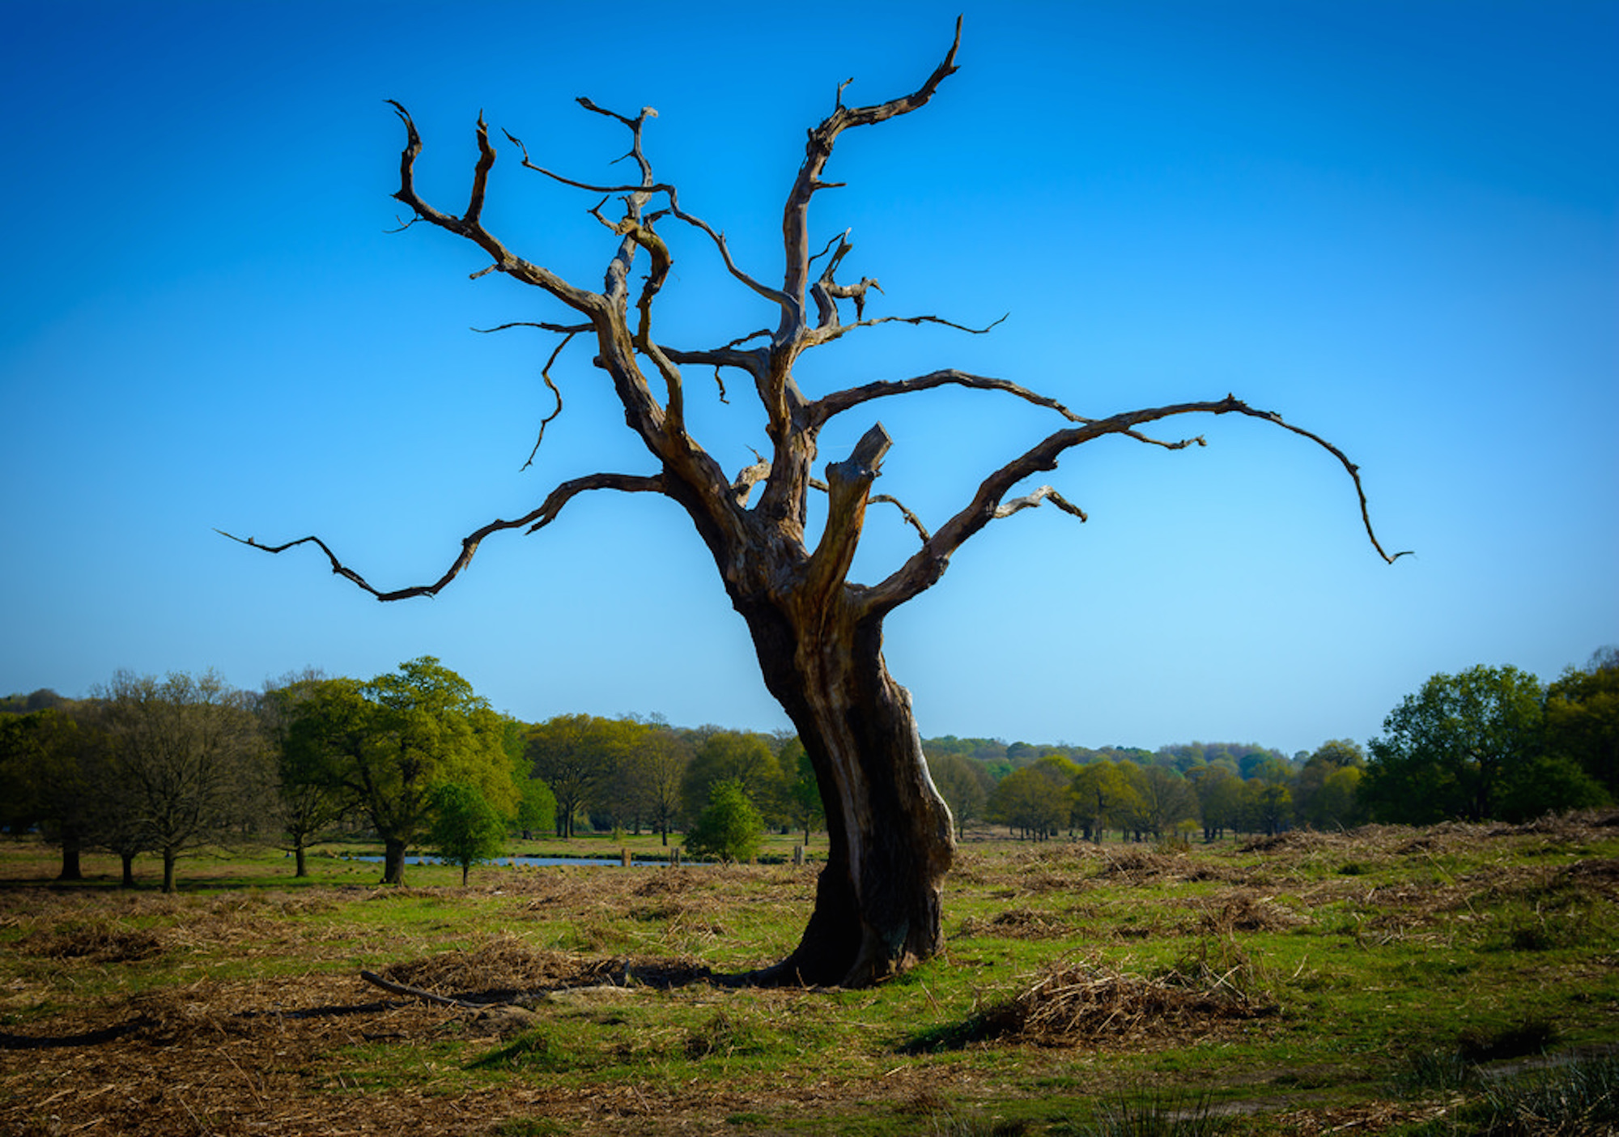
Text box
he was.
³⁵ Very early in the morning, while it was still dark, Jesus got up, left the house and went off to a solitary place, where he prayed. Simon and his companions went to look for him, ³⁷ and when they found him, they exclaimed: “Everyone is looking for you!”

Slide 15
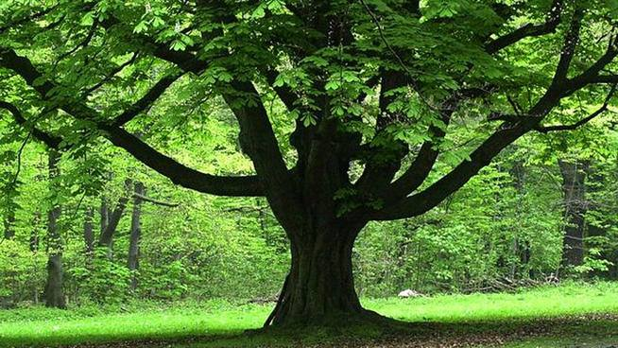
Text box
he was.
³⁵ Very early in the morning, while it was still dark, Jesus got up, left the house and went off to a solitary place, where he prayed. Simon and his companions went to look for him, ³⁷ and when they found him, they exclaimed: “Everyone is looking for you!”

Slide 16
Text box
How is your inner being?
How are your roots?
he was.
³⁵ Very early in the morning, while it was still dark, Jesus got up, left the house and went off to a solitary place, where he prayed. Simon and his companions went to look for him, ³⁷ and when they found him, they exclaimed: “Everyone is looking for you!”

