Slide 1
Text box
Mark 1:32-37
That evening after sunset the people brought to Jesus all the sick and demon-possessed. ³³ The whole town gathered at the door, ³⁴ and Jesus healed many who had various diseases. He also drove out many demons, but he would not let the demons speak because they knew who he was.
³⁵ Very early in the morning, while it was still dark, Jesus got up, left the house and went off to a solitary place, where he prayed. Simon and his companions went to look for him, ³⁷ and when they found him, they exclaimed: “Everyone is looking for you!”
Genesis 1:1-2
In the beginning God created the heavens and the earth. ² Now the earth was formless and empty, darkness was over the surface of the deep, and the Spirit of God was hovering over the waters.

Slide 2
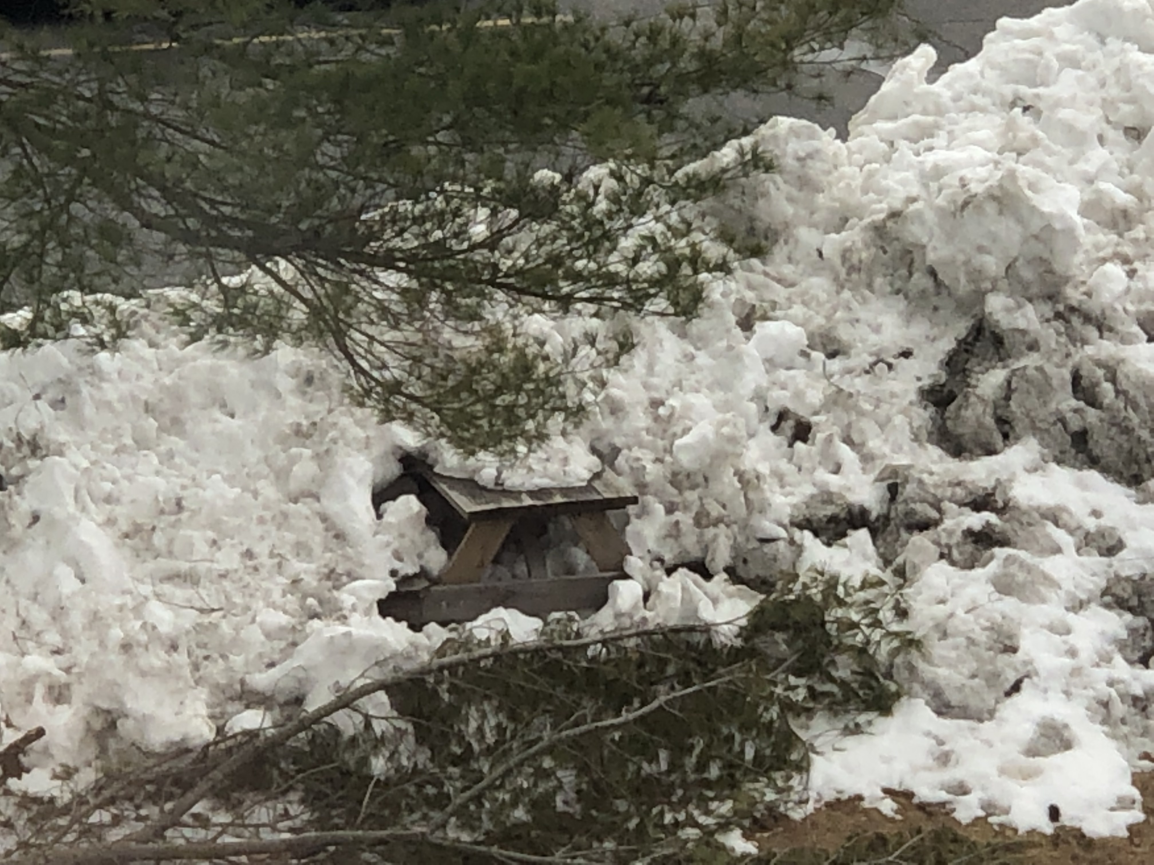
Text box
Mark 1:32-37
That evening after sunset the people brought to Jesus all the sick and demon-possessed. ³³ The whole town gathered at the door, ³⁴ and Jesus healed many who had various diseases. He also drove out many demons, but he would not let the demons speak because they knew who he was.
³⁵ Very early in the morning, while it was still dark, Jesus got up, left the house and went off to a solitary place, where he prayed. Simon and his companions went to look for him, ³⁷ and when they found him, they exclaimed: “Everyone is looking for you!”

Slide 3
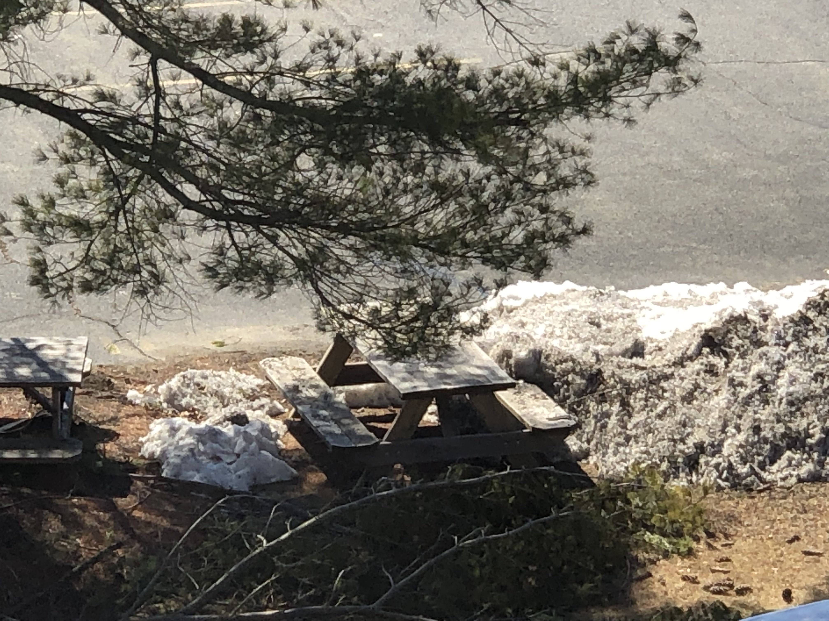
Text box
Mark 1:32-37
That evening after sunset the people brought to Jesus all the sick and demon-possessed. ³³ The whole town gathered at the door, ³⁴ and Jesus healed many who had various diseases. He also drove out many demons, but he would not let the demons speak because they knew who he was.
³⁵ Very early in the morning, while it was still dark, Jesus got up, left the house and went off to a solitary place, where he prayed. Simon and his companions went to look for him, ³⁷ and when they found him, they exclaimed: “Everyone is looking for you!”

Slide 4
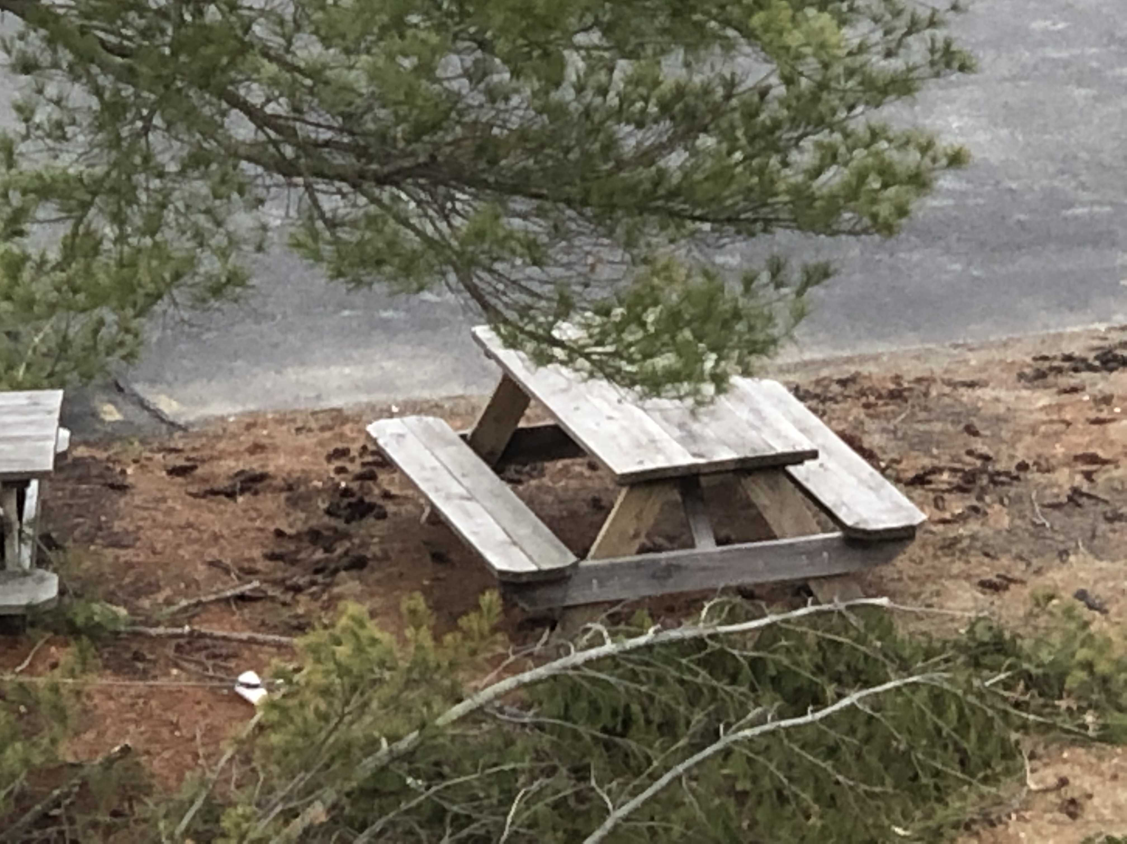
Text box
Mark 1:32-37
That evening after sunset the people brought to Jesus all the sick and demon-possessed. ³³ The whole town gathered at the door, ³⁴ and Jesus healed many who had various diseases. He also drove out many demons, but he would not let the demons speak because they knew who he was.
³⁵ Very early in the morning, while it was still dark, Jesus got up, left the house and went off to a solitary place, where he prayed. Simon and his companions went to look for him, ³⁷ and when they found him, they exclaimed: “Everyone is looking for you!”

Slide 5
Text box
Mark 1:32-37
That evening after sunset the people brought to Jesus all the sick and demon-possessed. ³³ The whole town gathered at the door, ³⁴ and Jesus healed many who had various diseases. He also drove out many demons, but he would not let the demons speak because they knew who he was.
³⁵ Very early in the morning, while it was still dark, Jesus got up, left the house and went off to a solitary place, where he prayed. Simon and his companions went to look for him, ³⁷ and when they found him, they exclaimed: “Everyone is looking for you!”

Slide 6
Text box
Sometimes powerful/obvious
Sometimes (often) subtle
Mark 1:32-37
That evening after sunset the people brought to Jesus all the sick and demon-possessed. ³³ The whole town gathered at the door, ³⁴ and Jesus healed many who had various diseases. He also drove out many demons, but he would not let the demons speak because they knew who he was.
³⁵ Very early in the morning, while it was still dark, Jesus got up, left the house and went off to a solitary place, where he prayed. Simon and his companions went to look for him, ³⁷ and when they found him, they exclaimed: “Everyone is looking for you!”

Slide 7
Text box
Luke 24:13-33
Now that same day two of them were going to a village called Emmaus, about seven miles from Jerusalem. ¹⁴ They were talking with each other about everything that had happened. ¹⁵ As they talked and discussed these things with each other, Jesus himself came up and walked along with them; ¹⁶ but they were kept from recognizing him.
¹⁷ He asked them, “What are you discussing together as you walk along?”
Mark 1:32-37
That evening after sunset the people brought to Jesus all the sick and demon-possessed. ³³ The whole town gathered at the door, ³⁴ and Jesus healed many who had various diseases. He also drove out many demons, but he would not let the demons speak because they knew who he was.
³⁵ Very early in the morning, while it was still dark, Jesus got up, left the house and went off to a solitary place, where he prayed. Simon and his companions went to look for him, ³⁷ and when they found him, they exclaimed: “Everyone is looking for you!”

Slide 8
Text box
Luke 24:13-33
They stood still, their faces downcast. ¹⁸ One of them, named Cleopas, asked him, “Are you the only one visiting Jerusalem who does not know the things that have happened there in these days?”
¹⁹ “What things?” he asked.
Mark 1:32-37
That evening after sunset the people brought to Jesus all the sick and demon-possessed. ³³ The whole town gathered at the door, ³⁴ and Jesus healed many who had various diseases. He also drove out many demons, but he would not let the demons speak because they knew who he was.
³⁵ Very early in the morning, while it was still dark, Jesus got up, left the house and went off to a solitary place, where he prayed. Simon and his companions went to look for him, ³⁷ and when they found him, they exclaimed: “Everyone is looking for you!”

Slide 9
Text box
Luke 24:13-33
“About Jesus of Nazareth,” they replied. “He was a prophet, powerful in word and deed before God and all the people. ²⁰ The chief priests and our rulers handed him over to be sentenced to death, and they crucified him; ²¹ but we had hoped that he was the one who was going to redeem Israel. And what is more, it is the third day since all this took place.
Mark 1:32-37
That evening after sunset the people brought to Jesus all the sick and demon-possessed. ³³ The whole town gathered at the door, ³⁴ and Jesus healed many who had various diseases. He also drove out many demons, but he would not let the demons speak because they knew who he was.
³⁵ Very early in the morning, while it was still dark, Jesus got up, left the house and went off to a solitary place, where he prayed. Simon and his companions went to look for him, ³⁷ and when they found him, they exclaimed: “Everyone is looking for you!”

Slide 10
Text box
Luke 24:13-33
²² In addition, some of our women amazed us. They went to the tomb early this morning ²³ but didn’t find his body. They came and told us that they had seen a vision of angels, who said he was alive. ²⁴ Then some of our companions went to the tomb and found it just as the women had said, but they did not see Jesus.”
Mark 1:32-37
That evening after sunset the people brought to Jesus all the sick and demon-possessed. ³³ The whole town gathered at the door, ³⁴ and Jesus healed many who had various diseases. He also drove out many demons, but he would not let the demons speak because they knew who he was.
³⁵ Very early in the morning, while it was still dark, Jesus got up, left the house and went off to a solitary place, where he prayed. Simon and his companions went to look for him, ³⁷ and when they found him, they exclaimed: “Everyone is looking for you!”

Slide 11
Text box
Luke 24:13-33
²⁵ He said to them, “How foolish you are, and how slow to believe all that the prophets have spoken! ²⁶ Did not the Messiah have to suffer these things and then enter his glory?” ²⁷ And beginning with Moses and all the Prophets, he explained to them what was said in all the Scriptures concerning himself.
Mark 1:32-37
That evening after sunset the people brought to Jesus all the sick and demon-possessed. ³³ The whole town gathered at the door, ³⁴ and Jesus healed many who had various diseases. He also drove out many demons, but he would not let the demons speak because they knew who he was.
³⁵ Very early in the morning, while it was still dark, Jesus got up, left the house and went off to a solitary place, where he prayed. Simon and his companions went to look for him, ³⁷ and when they found him, they exclaimed: “Everyone is looking for you!”

Slide 12
Text box
Luke 24:13-33
²⁸ As they approached the village to which they were going, Jesus continued on as if he were going farther. ²⁹ But they urged him strongly, “Stay with us, for it is nearly evening; the day is almost over.” So he went in to stay with them.
Mark 1:32-37
That evening after sunset the people brought to Jesus all the sick and demon-possessed. ³³ The whole town gathered at the door, ³⁴ and Jesus healed many who had various diseases. He also drove out many demons, but he would not let the demons speak because they knew who he was.
³⁵ Very early in the morning, while it was still dark, Jesus got up, left the house and went off to a solitary place, where he prayed. Simon and his companions went to look for him, ³⁷ and when they found him, they exclaimed: “Everyone is looking for you!”

Slide 13
Text box
Luke 24:13-33
³⁰ When he was at the table with them, he took bread, gave thanks, broke it and began to give it to them. ³¹ Then their eyes were opened and they recognized him, and he disappeared from their sight. ³² They asked each other, “Were not our hearts burning within us while he talked with us on the road and opened the Scriptures to us?”
Mark 1:32-37
That evening after sunset the people brought to Jesus all the sick and demon-possessed. ³³ The whole town gathered at the door, ³⁴ and Jesus healed many who had various diseases. He also drove out many demons, but he would not let the demons speak because they knew who he was.
³⁵ Very early in the morning, while it was still dark, Jesus got up, left the house and went off to a solitary place, where he prayed. Simon and his companions went to look for him, ³⁷ and when they found him, they exclaimed: “Everyone is looking for you!”

Slide 14
Text box
Luke 24:13-33
³³ They got up and returned at once to Jerusalem. There they found the Eleven and those with them, assembled together ³⁴ and saying, “It is true! The Lord has risen and has appeared to Simon.” ³⁵ Then the two told what had happened on the way, and how Jesus was recognized by them when he broke the bread.
Mark 1:32-37
That evening after sunset the people brought to Jesus all the sick and demon-possessed. ³³ The whole town gathered at the door, ³⁴ and Jesus healed many who had various diseases. He also drove out many demons, but he would not let the demons speak because they knew who he was.
³⁵ Very early in the morning, while it was still dark, Jesus got up, left the house and went off to a solitary place, where he prayed. Simon and his companions went to look for him, ³⁷ and when they found him, they exclaimed: “Everyone is looking for you!”

Slide 15
Text box
Luke 24:13-33
Possibility (v1-12) gives way to…
Probability (v13-35) which gives way to…
Actuality (v36-49) which gives way to…
Resolution (v50-53)
Mark 1:32-37
That evening after sunset the people brought to Jesus all the sick and demon-possessed. ³³ The whole town gathered at the door, ³⁴ and Jesus healed many who had various diseases. He also drove out many demons, but he would not let the demons speak because they knew who he was.
³⁵ Very early in the morning, while it was still dark, Jesus got up, left the house and went off to a solitary place, where he prayed. Simon and his companions went to look for him, ³⁷ and when they found him, they exclaimed: “Everyone is looking for you!”

Slide 16
Text box
Luke 24:13-33
Possibility (v1-12) gives way to…
Probability (v13-35) which gives way to…
Actuality (v36-49) which gives way to…
Resolution = we have to do something about this!
Mark 1:32-37
That evening after sunset the people brought to Jesus all the sick and demon-possessed. ³³ The whole town gathered at the door, ³⁴ and Jesus healed many who had various diseases. He also drove out many demons, but he would not let the demons speak because they knew who he was.
³⁵ Very early in the morning, while it was still dark, Jesus got up, left the house and went off to a solitary place, where he prayed. Simon and his companions went to look for him, ³⁷ and when they found him, they exclaimed: “Everyone is looking for you!”

Slide 17
Text box
YOU can encounter God
Sometimes it is powerful/obvious
Sometimes it happens as we ‘walk along the road’.
Mark 1:32-37
That evening after sunset the people brought to Jesus all the sick and demon-possessed. ³³ The whole town gathered at the door, ³⁴ and Jesus healed many who had various diseases. He also drove out many demons, but he would not let the demons speak because they knew who he was.
³⁵ Very early in the morning, while it was still dark, Jesus got up, left the house and went off to a solitary place, where he prayed. Simon and his companions went to look for him, ³⁷ and when they found him, they exclaimed: “Everyone is looking for you!”

Slide 18
Text box
Mark 1:32-37
That evening after sunset the people brought to Jesus all the sick and demon-possessed. ³³ The whole town gathered at the door, ³⁴ and Jesus healed many who had various diseases. He also drove out many demons, but he would not let the demons speak because they knew who he was.
³⁵ Very early in the morning, while it was still dark, Jesus got up, left the house and went off to a solitary place, where he prayed. Simon and his companions went to look for him, ³⁷ and when they found him, they exclaimed: “Everyone is looking for you!”
Genesis 1:1-2
In the beginning God created the heavens and the earth. ² Now the earth was formless and empty, darkness was over the surface of the deep, and the Spirit of God was hovering over the waters.

