Slide 1
ABIDE IN ME

Slide 3
Season of loss
Prayer vision: Do you trust me?

Slide 5
I am the true vine, and my Father is the vinedresser. Every branch in me that does not bear fruit he takes away, and every branch that does bear fruit he prunes, that it may bear more fruit. Already you are clean because of the word that I have spoken to you. Abide in me, and I in you…
John 15:1-11 (ESV)

Slide 6
…As the branch cannot bear fruit by itself, unless it abides in the vine, neither can you, unless you abide in me. I am the vine; you are the branches. Whoever abides in me and I in him, he it is that bears much fruit, for apart from me you can do nothing…
John 15:1-11 (ESV)

Slide 7
…If anyone does not abide in me he is thrown away like a branch and withers; and the branches are gathered, thrown into the fire, and burned. If you abide in me, and my words abide in you, ask whatever you wish, and it will be done for you. By this my Father is glorified, that you bear much fruit and so prove to be my disciples…
John 15:1-11 (ESV)

Slide 8
...As the Father has loved me, so have I loved you. Abide in my love. If you keep my commandments, you will abide in my love, just as I have kept my Father's commandments and abide in his love. These things I have spoken to you, that my joy may be in you, and that your joy may be full.
John 15:1-11 (ESV)

Slide 9
Meno (μένω) : dwell, remain, stay united with
CONTEXT

Slide 10
Old Covenant: God dwells in the Temple
Last Supper
Jesus Preps Disciples for:
Losing Him
Receiving Him again after His death
CONTEXT

Slide 12
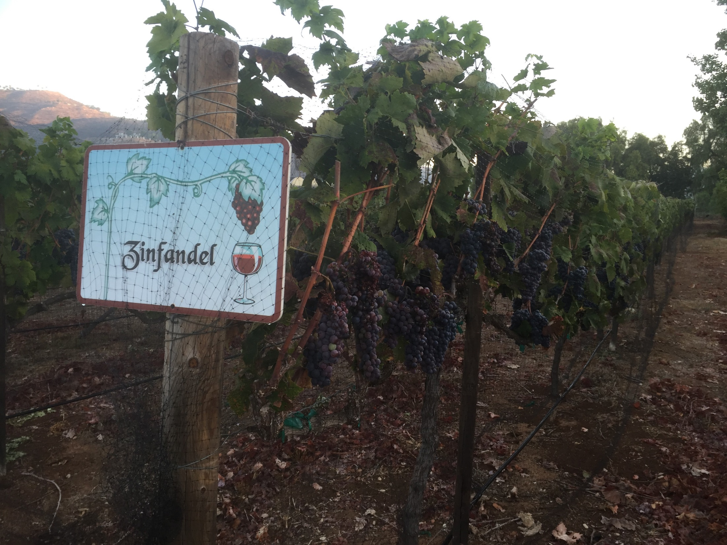
PROCESS

Slide 13
Grapes: a primer
Allegory: view in larger theological context
PROCESS

Slide 14
Airo (αἴρω) : take away or lift up
PROCESS

Slide 15
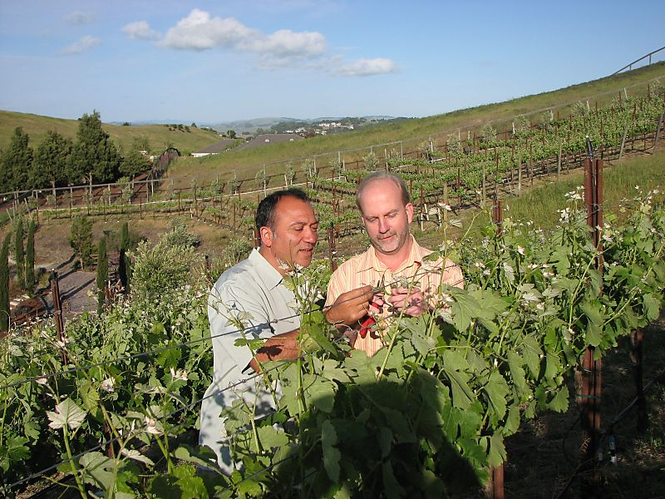
PROCESS

Slide 16
PROCESS

Slide 17
Call to trust in response to coming crucifixion
Abiding toward joy – filling
Abiding toward heart alignment
OUTCOME

Slide 18
OUTCOME

Slide 20
“…solitude is not a private therapeutic place. Rather it is the place of conversion, the place where the old self dies and the new self is born…In solitude I get rid of my scaffolding: no friends to talk with, no telephone calls to make, no meetings to attend…no books to distract, just me.” – H. Nouwen

