Slide 1
Text box
he was.
³⁵ Very early in the morning, while it was still dark, Jesus got up, left the house and went off to a solitary place, where he prayed. Simon and his companions went to look for him, ³⁷ and when they found him, they exclaimed: “Everyone is looking for you!”
Palm Sunday:
Hold Music. A Donkey. And ever decreasing Circes.

Slide 2
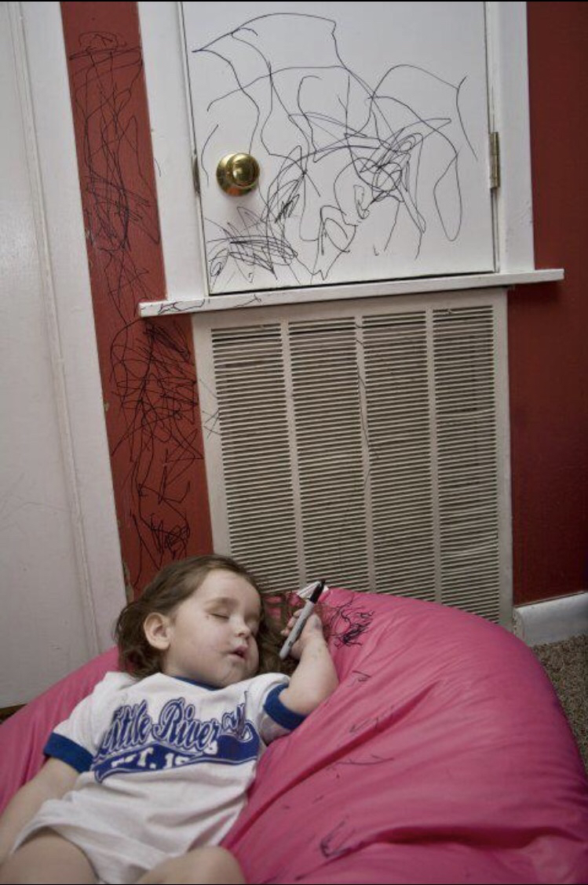
Text box
he was.
³⁵ Very early in the morning, while it was still dark, Jesus got up, left the house and went off to a solitary place, where he prayed. Simon and his companions went to look for him, ³⁷ and when they found him, they exclaimed: “Everyone is looking for you!”

Slide 3
Text box
he was.
³⁵ Very early in the morning, while it was still dark, Jesus got up, left the house and went off to a solitary place, where he prayed. Simon and his companions went to look for him, ³⁷ and when they found him, they exclaimed: “Everyone is looking for you!”
Luke 19:28-40
After Jesus had said this, he went on ahead, going up to Jerusalem. ²⁹ As he approached Bethphage and Bethany at the hill called the Mount of Olives, he sent two of his disciples, saying to them, ³⁰ “Go to the village ahead of you, and as you enter it, you will find a colt tied there, which no one has ever ridden. Untie it and bring it here. ³¹ If anyone asks you, ‘Why are you untying it?’ say, ‘The Lord needs it.’”

Slide 4
Text box
he was.
³⁵ Very early in the morning, while it was still dark, Jesus got up, left the house and went off to a solitary place, where he prayed. Simon and his companions went to look for him, ³⁷ and when they found him, they exclaimed: “Everyone is looking for you!”
Luke 19:28-40
Those who were sent ahead went and found it just as he had told them. ³³ As they were untying the colt, its owners asked them, “Why are you untying the colt?”
³⁴ They replied, “The Lord needs it.”
³⁵ They brought it to Jesus, threw their cloaks on the colt and put Jesus on it. ³⁶ As he went along, people spread their cloaks on the road.

Slide 5
Text box
he was.
³⁵ Very early in the morning, while it was still dark, Jesus got up, left the house and went off to a solitary place, where he prayed. Simon and his companions went to look for him, ³⁷ and when they found him, they exclaimed: “Everyone is looking for you!”
Luke 19:28-40
³⁷ When he came near the place where the road goes down the Mount of Olives, the whole crowd of disciples began joyfully to praise God in loud voices for all the miracles they had seen:
³⁸ “Blessed is the king who comes in the name of the Lord!”
“Peace in heaven and glory in the highest!”

Slide 6
Text box
he was.
³⁵ Very early in the morning, while it was still dark, Jesus got up, left the house and went off to a solitary place, where he prayed. Simon and his companions went to look for him, ³⁷ and when they found him, they exclaimed: “Everyone is looking for you!”
Luke 19:28-40
³⁹ Some of the Pharisees in the crowd said to Jesus, “Teacher, rebuke your disciples!”
⁴⁰ “I tell you,” he replied, “if they keep quiet, the stones will cry out.”

Slide 7
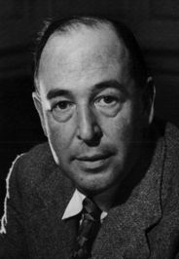
Text box
he was.
³⁵ Very early in the morning, while it was still dark, Jesus got up, left the house and went off to a solitary place, where he prayed. Simon and his companions went to look for him, ³⁷ and when they found him, they exclaimed: “Everyone is looking for you!”
“Aslan is a lion- the Lion, the great Lion." "Ooh" said Susan. "I'd thought he was a man. Is he safe? I shall feel rather nervous about meeting a lion"..."Safe?" said Mr Beaver
..."Who said anything about safe? 'Course he isn't safe. But he's good. He's the King, I tell you.
C.S Lewis

Slide 8
Text box
he was.
³⁵ Very early in the morning, while it was still dark, Jesus got up, left the house and went off to a solitary place, where he prayed. Simon and his companions went to look for him, ³⁷ and when they found him, they exclaimed: “Everyone is looking for you!”
Crowds
Multitudes
Disciples
Which one are you?

