Slide 1
Text box
he was.
³⁵ Very early in the morning, while it was still dark, Jesus got up, left the house and went off to a solitary place, where he prayed. Simon and his companions went to look for him, ³⁷ and when they found him, they exclaimed: “Everyone is looking for you!”

Slide 2
Text box
When the Harvest is Ready
Acts 2
he was.
³⁵ Very early in the morning, while it was still dark, Jesus got up, left the house and went off to a solitary place, where he prayed. Simon and his companions went to look for him, ³⁷ and when they found him, they exclaimed: “Everyone is looking for you!”

Slide 3
Acts 2 (The Passion Translation)

Slide 12
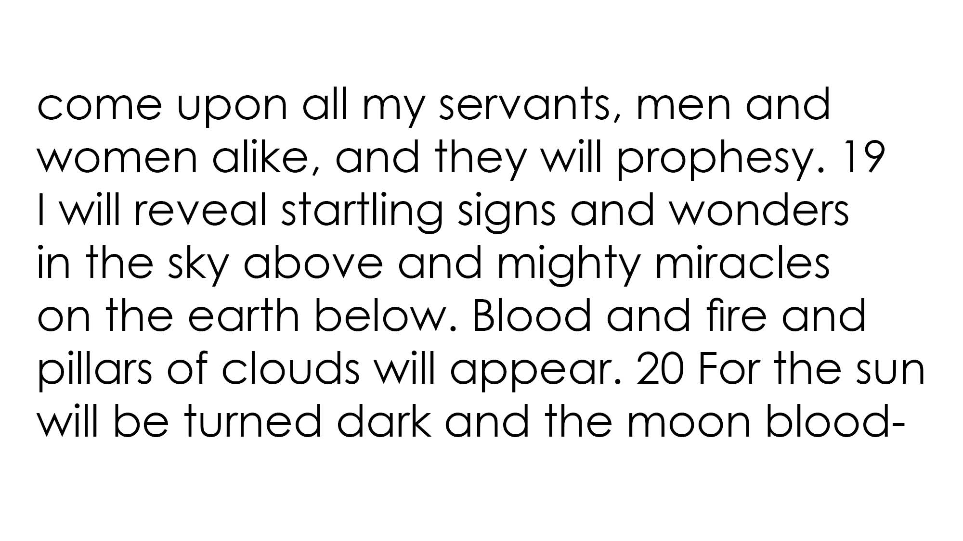

Slide 33
Text box
he was.
³⁵ Very early in the morning, while it was still dark, Jesus got up, left the house and went off to a solitary place, where he prayed. Simon and his companions went to look for him, ³⁷ and when they found him, they exclaimed: “Everyone is looking for you!”
Transformation
Truth
Invasion

Slide 34
Text box
he was.
³⁵ Very early in the morning, while it was still dark, Jesus got up, left the house and went off to a solitary place, where he prayed. Simon and his companions went to look for him, ³⁷ and when they found him, they exclaimed: “Everyone is looking for you!”
1. The Spirit Transforms

Slide 36
Text box
Mat. 3:11
¹¹ As for me, I baptize you with water for repentance, but He who is coming after me…will baptize you with the Holy Spirit and fire.
he was.
³⁵ Very early in the morning, while it was still dark, Jesus got up, left the house and went off to a solitary place, where he prayed. Simon and his companions went to look for him, ³⁷ and when they found him, they exclaimed: “Everyone is looking for you!”

Slide 37
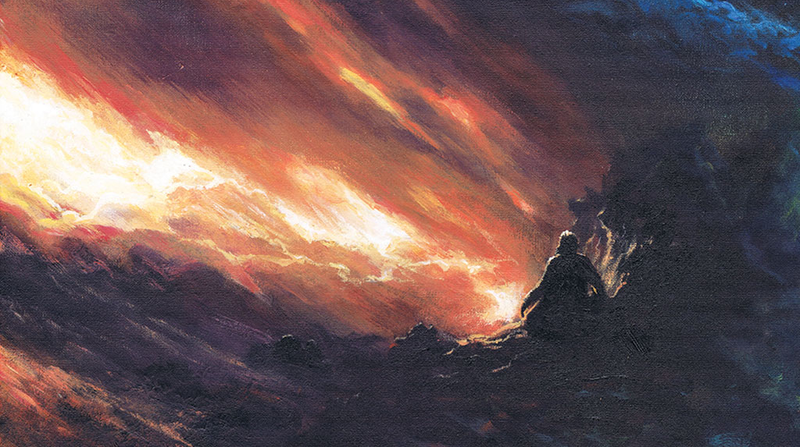

Slide 38
Text box
“the Spirit of the Lord came upon [the prophets]. Everything changed in that moment. They went from a respected citizen of a city to a feared citizen of Heaven.”
Bill Johnson
he was.
³⁵ Very early in the morning, while it was still dark, Jesus got up, left the house and went off to a solitary place, where he prayed. Simon and his companions went to look for him, ³⁷ and when they found him, they exclaimed: “Everyone is looking for you!”

Slide 39
Text box
Romans 8:15
¹⁵ For you have not received a spirit of slavery leading to fear again, but you have received a spirit of adoption as sons by which we cry out, “Abba! Father!”
he was.
³⁵ Very early in the morning, while it was still dark, Jesus got up, left the house and went off to a solitary place, where he prayed. Simon and his companions went to look for him, ³⁷ and when they found him, they exclaimed: “Everyone is looking for you!”

Slide 40
Text box
Romans 8:16-17
The Spirit Himself testifies with our spirit that we are children of God, and if children, heirs also, heirs of God and fellow heirs with Christ, if indeed we suffer with Him so that we may also be glorified with Him.”
he was.
³⁵ Very early in the morning, while it was still dark, Jesus got up, left the house and went off to a solitary place, where he prayed. Simon and his companions went to look for him, ³⁷ and when they found him, they exclaimed: “Everyone is looking for you!”

Slide 41
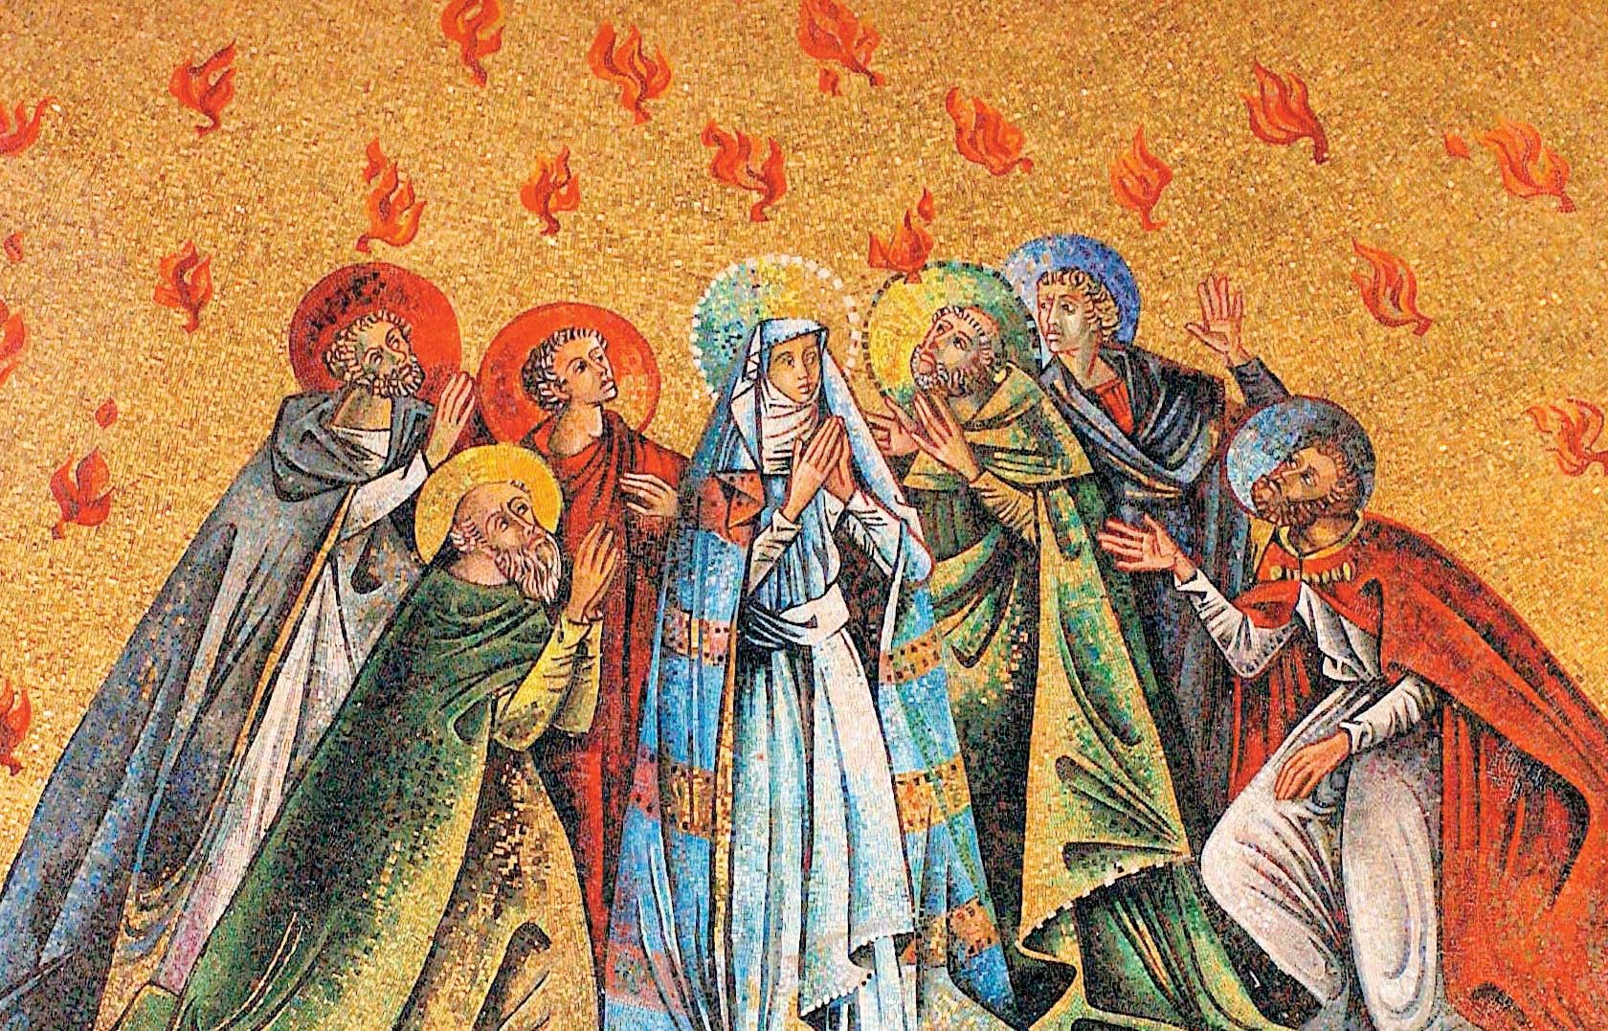

Slide 42
Text box
Acts 1:7-8
⁸ But you will receive power when the Holy Spirit comes on you; and you will be my witnesses in Jerusalem, and in all Judea and Samaria, and to the ends of the earth.”
he was.
³⁵ Very early in the morning, while it was still dark, Jesus got up, left the house and went off to a solitary place, where he prayed. Simon and his companions went to look for him, ³⁷ and when they found him, they exclaimed: “Everyone is looking for you!”

Slide 43
Text box
he was.
³⁵ Very early in the morning, while it was still dark, Jesus got up, left the house and went off to a solitary place, where he prayed. Simon and his companions went to look for him, ³⁷ and when they found him, they exclaimed: “Everyone is looking for you!”
Peter: from afraid to the face of a movement

Slide 44
Text box
he was.
³⁵ Very early in the morning, while it was still dark, Jesus got up, left the house and went off to a solitary place, where he prayed. Simon and his companions went to look for him, ³⁷ and when they found him, they exclaimed: “Everyone is looking for you!”
2. The Spirit brings
Deep Truth

Slide 45
Text box
he was.
³⁵ Very early in the morning, while it was still dark, Jesus got up, left the house and went off to a solitary place, where he prayed. Simon and his companions went to look for him, ³⁷ and when they found him, they exclaimed: “Everyone is looking for you!”
37 Now when they heard this, they were pierced to the heart

Slide 46
Text box
Pilgrimage Festivals
he was.
³⁵ Very early in the morning, while it was still dark, Jesus got up, left the house and went off to a solitary place, where he prayed. Simon and his companions went to look for him, ³⁷ and when they found him, they exclaimed: “Everyone is looking for you!”
Pesach (Passover)
Shavuot (Weeks / Pentecost)
Sukkot

Slide 47
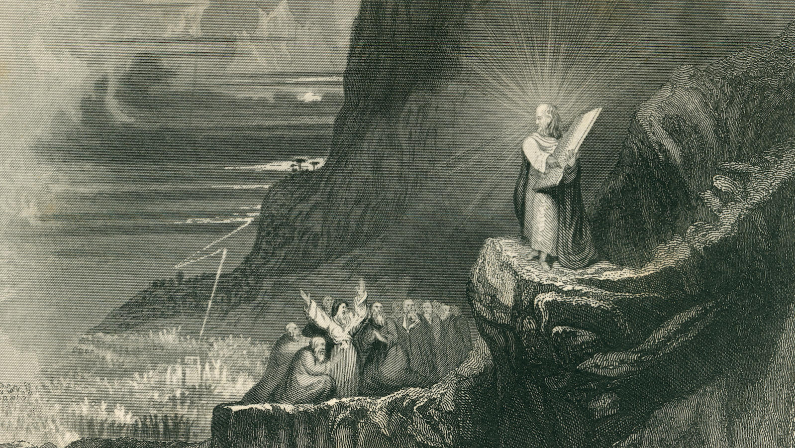

Slide 48
Text box
Deut. 5:25
²⁵ …For this great fire will consume us; if we hear the voice* of the LORD our God any longer, then we will die.
קוֹל*
he was.
³⁵ Very early in the morning, while it was still dark, Jesus got up, left the house and went off to a solitary place, where he prayed. Simon and his companions went to look for him, ³⁷ and when they found him, they exclaimed: “Everyone is looking for you!”

Slide 49
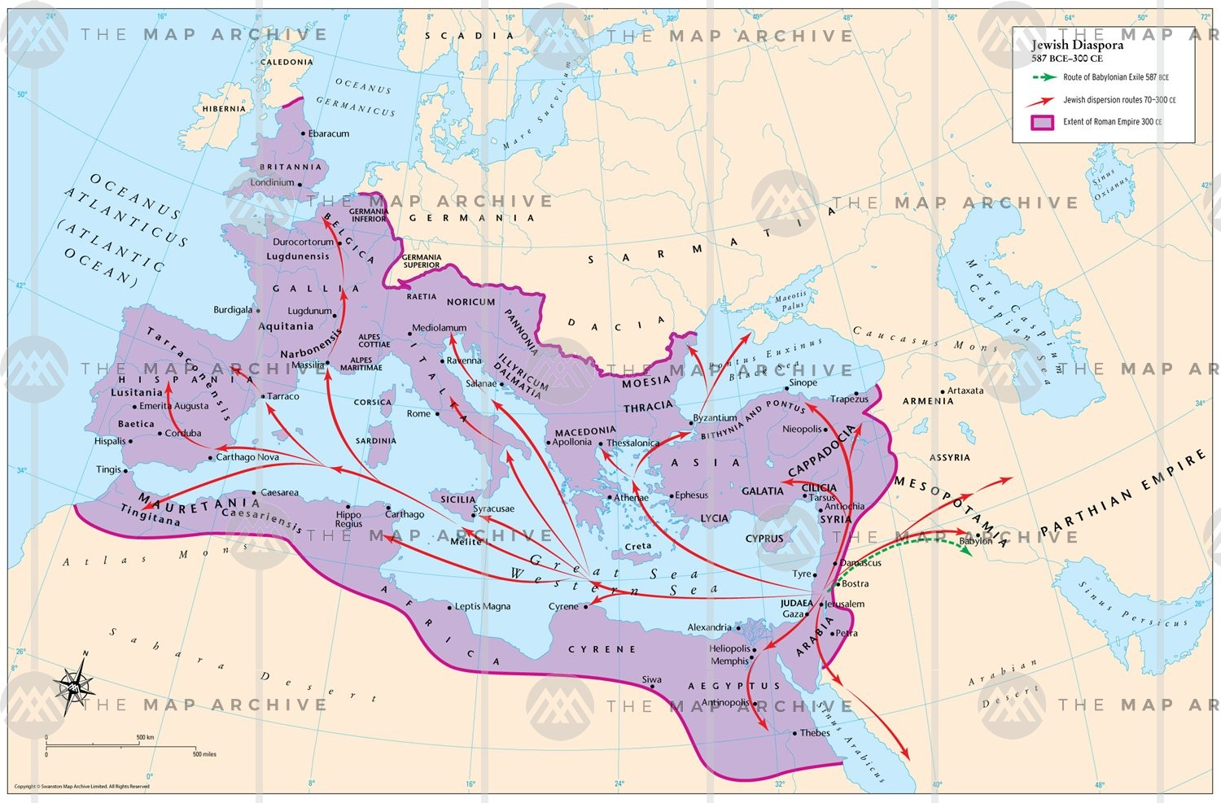

Slide 50
Text box
he was.
³⁵ Very early in the morning, while it was still dark, Jesus got up, left the house and went off to a solitary place, where he prayed. Simon and his companions went to look for him, ³⁷ and when they found him, they exclaimed: “Everyone is looking for you!”
I Love You

Slide 51
Text box
he was.
³⁵ Very early in the morning, while it was still dark, Jesus got up, left the house and went off to a solitary place, where he prayed. Simon and his companions went to look for him, ³⁷ and when they found him, they exclaimed: “Everyone is looking for you!”
3. The Spirit Invades
Earth with Heaven

Slide 52
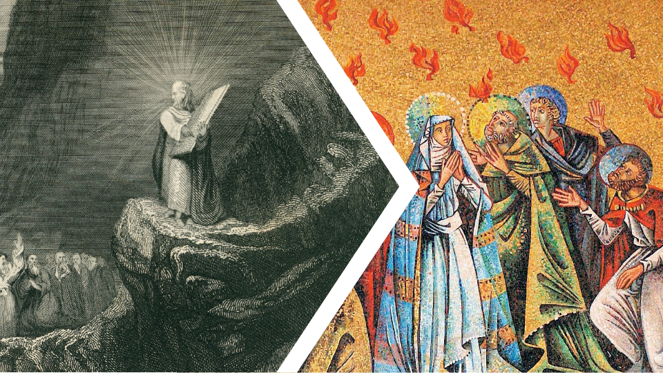

Slide 53
Text box
“When the Spirit of God comes upon people, they do extraordinary things in His name,”
Bill Johnson
he was.
³⁵ Very early in the morning, while it was still dark, Jesus got up, left the house and went off to a solitary place, where he prayed. Simon and his companions went to look for him, ³⁷ and when they found him, they exclaimed: “Everyone is looking for you!”

Slide 54
Text box
42 They were continually devoting themselves to the apostles’ teaching and to fellowship, to the breaking of bread and to prayer.
he was.
³⁵ Very early in the morning, while it was still dark, Jesus got up, left the house and went off to a solitary place, where he prayed. Simon and his companions went to look for him, ³⁷ and when they found him, they exclaimed: “Everyone is looking for you!”

Slide 55
Text box
43 Everyone kept feeling a sense of awe; and many wonders and signs were taking place through the apostles. And all those who had believed were together and had all things in common;
he was.
³⁵ Very early in the morning, while it was still dark, Jesus got up, left the house and went off to a solitary place, where he prayed. Simon and his companions went to look for him, ³⁷ and when they found him, they exclaimed: “Everyone is looking for you!”

Slide 56
Text box
46 Day by day continuing with one mind in the temple, and breaking bread from house to house, they were taking their meals together with gladness and sincerity of heart…
he was.
³⁵ Very early in the morning, while it was still dark, Jesus got up, left the house and went off to a solitary place, where he prayed. Simon and his companions went to look for him, ³⁷ and when they found him, they exclaimed: “Everyone is looking for you!”

