Slide 1
Love is seeing God’s heart for things purely. His eyes see the whole story of what He’s doing.
Notes:
Grace for gifts: the gifts are given to us with a grace on them, an anointing to operate in them. When there is an anointing God moves us toward His fullness. He matures us when we partner with Him in the ways that He’s given us grace.

Slide 2
FIRST LOVE

Slide 3
Love is seeing God’s heart for things purely. His eyes see the whole story of what He’s doing.
Notes:
Grace for gifts: the gifts are given to us with a grace on them, an anointing to operate in them. When there is an anointing God moves us toward His fullness. He matures us when we partner with Him in the ways that He’s given us grace.

Slide 4
EPHESIANS 4:11-16 NLT
13 …until we all come to such unity in our faith and knowledge of God’s Son that we will be mature in the Lord, measuring up to the full and complete standard of Christ.

Slide 5
EPHESIANS 4:11-16 NLT
16 He makes the whole body fit together perfectly. As each part does its own special work, it helps the other parts grow, so that the whole body is healthy and growing and full of love.

Slide 6
Love is seeing God’s heart for things purely. His eyes see the whole story of what He’s doing.
Notes:
Grace for gifts: the gifts are given to us with a grace on them, an anointing to operate in them. When there is an anointing God moves us toward His fullness. He matures us when we partner with Him in the ways that He’s given us grace.

Slide 7
REVELATIONS 2:2-5 NIV
2 I know your deeds, your hard work and your perseverance. I know that you cannot tolerate wicked people, that you have tested those who claim to be apostles but are not, and have found them false. 3 You have persevered and have endured hardships for my name, and have not grown weary.

Slide 8
REVELATIONS 2:2-5 NIV
4 Yet I hold this against you: You have forsaken the love you had at first. 5 Consider how far you have fallen! Repent and do the things you did at first.

Slide 9
Love is seeing God’s heart for things purely. His eyes see the whole story of what He’s doing.
Notes:
Grace for gifts: the gifts are given to us with a grace on them, an anointing to operate in them. When there is an anointing God moves us toward His fullness. He matures us when we partner with Him in the ways that He’s given us grace.

Slide 10
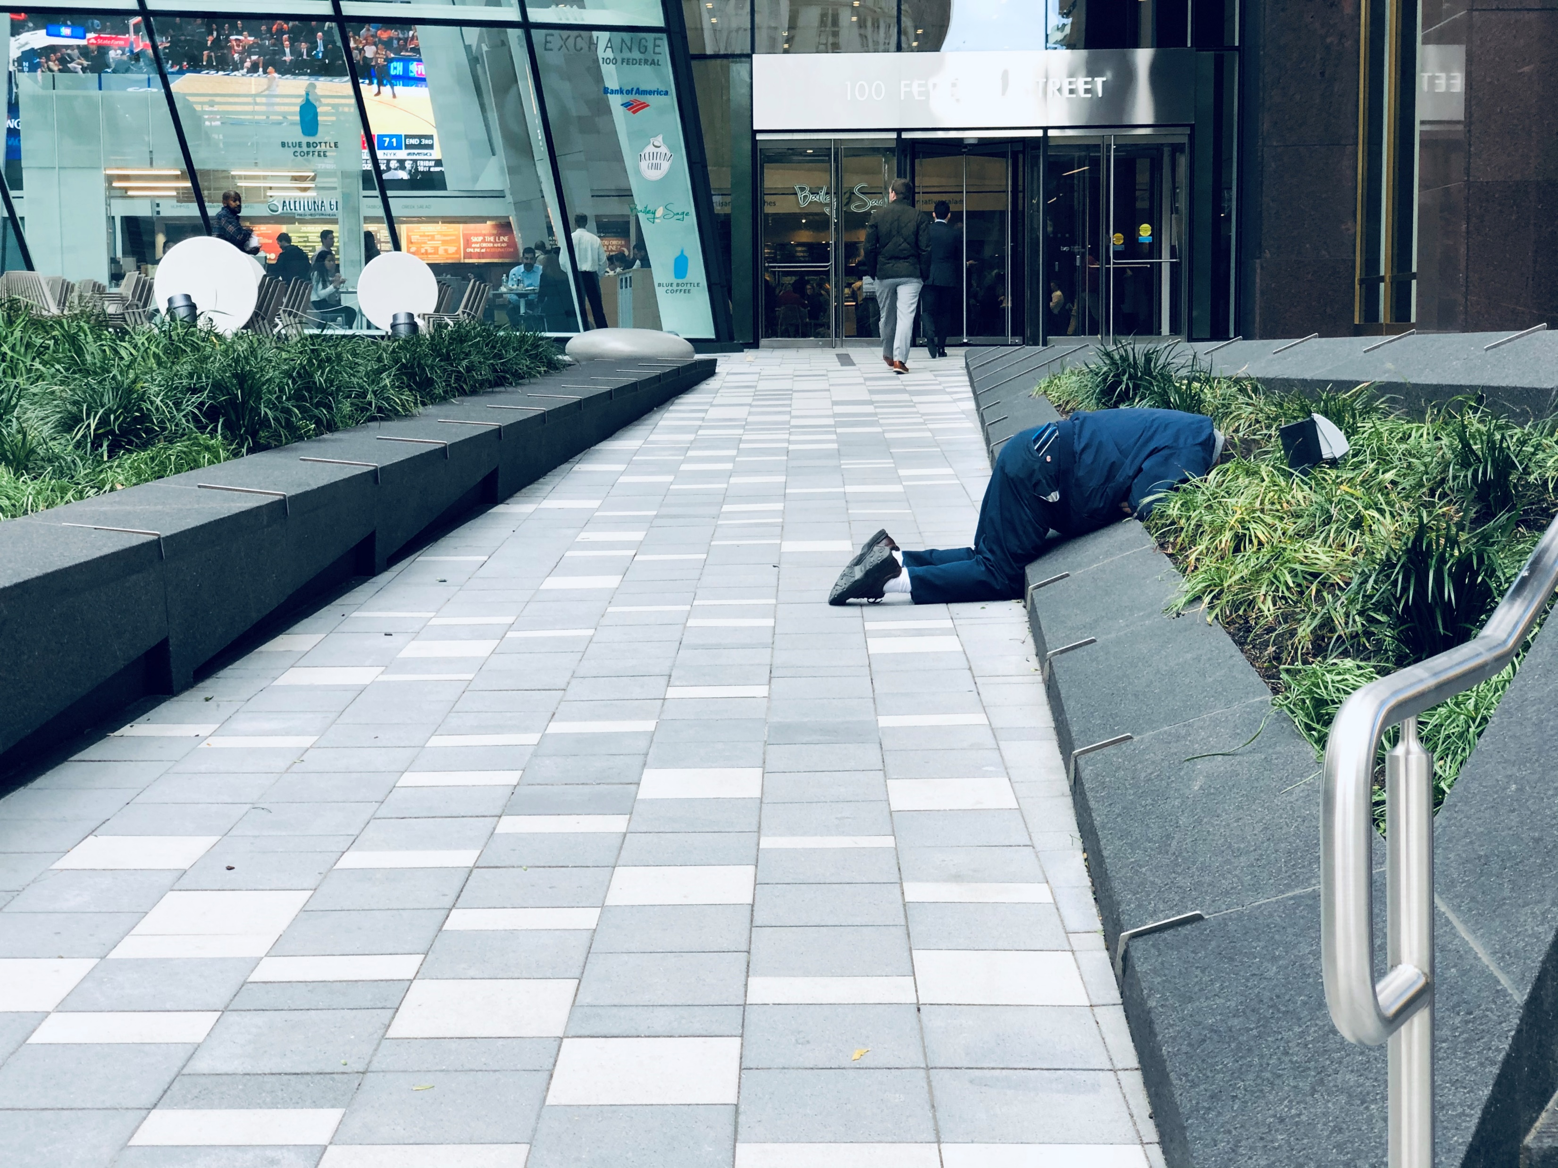
#FEELS

Slide 11
Love is seeing God’s heart for things purely. His eyes see the whole story of what He’s doing.
Notes:
Grace for gifts: the gifts are given to us with a grace on them, an anointing to operate in them. When there is an anointing God moves us toward His fullness. He matures us when we partner with Him in the ways that He’s given us grace.

